Slide 1
Predicting bandgap in strain-engineered multinary III-V semiconductors
DPG-Frühjahrstagung (SKM) 2023
28/03/2023
Badal Mondal, Ralf Tonner-Zech
Wilhelm-Ostwald-Institute für Physikalische und Theoretische Chemie
Fakultät für Chemie und Mineralogie
Universität Leipzig

Slide 2
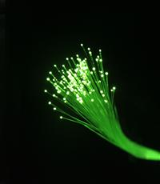
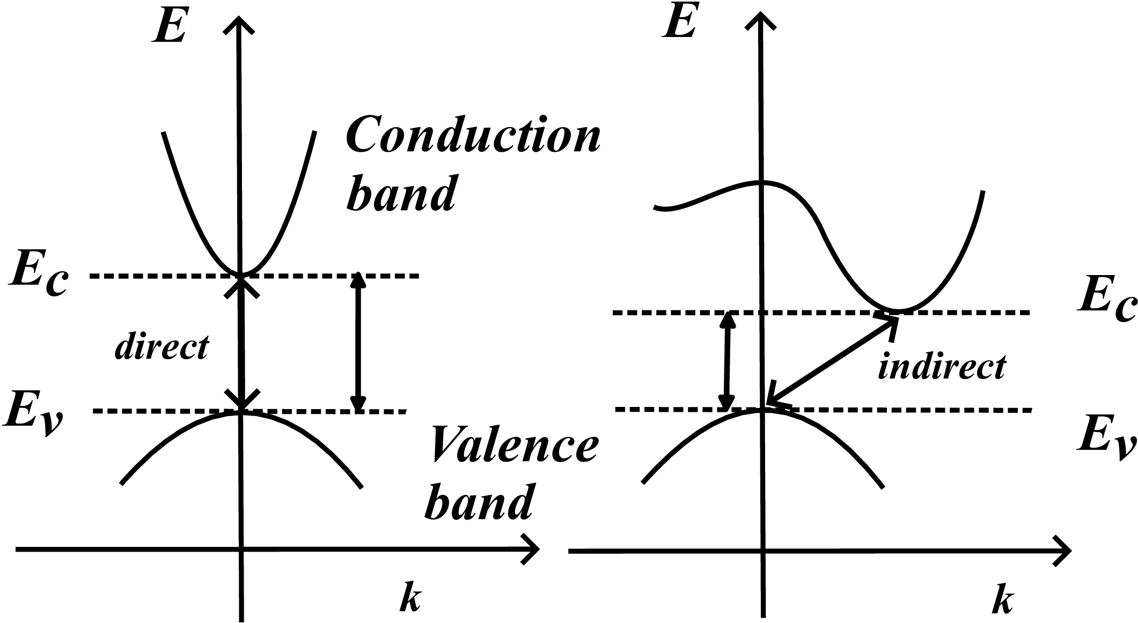
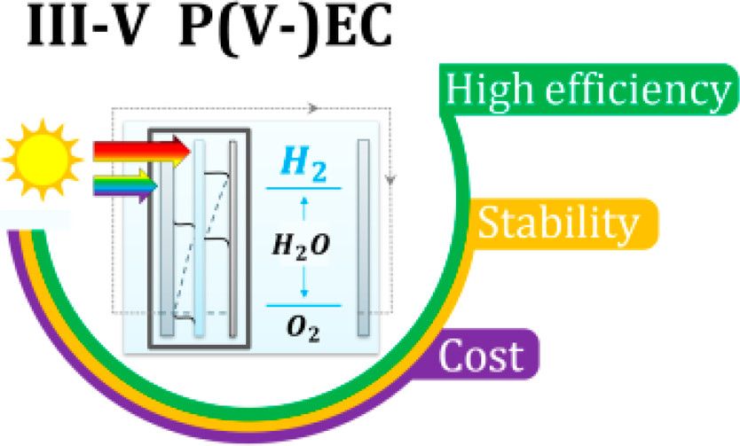
Introduction
Int. J. Sci (2014)
Target optical property
Bandgap (value, type)
Bandgap tuning
ACS Energy Lett. 5,611 (2020)
2

Slide 3
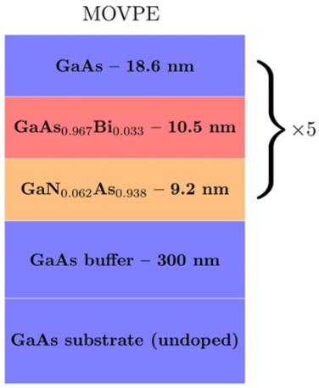
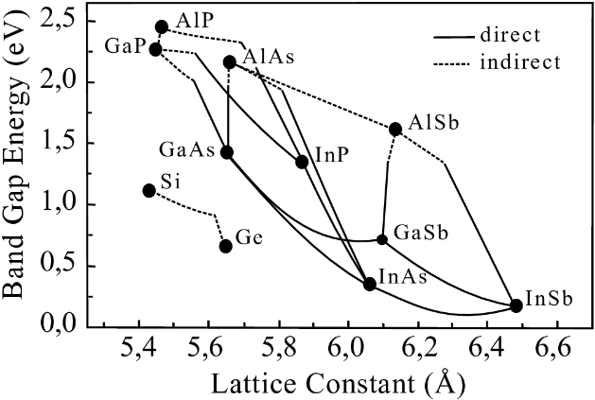
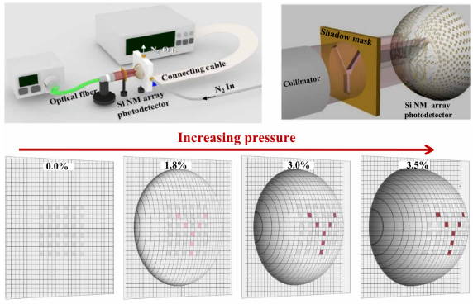
Motivation
Appl. Phys. A 69, 119 (1999)
Sci. Adv. 6, eabb0576 (2020)
Sci. Rep. 7, 46371 (2017)
compositional engineering
strain engineering
compositional + strain engineering
Comprehensive search experimentally not feasible
Developing a predictive theoretical (computational) approach
Composition-strain-bandgap map
3

Slide 4
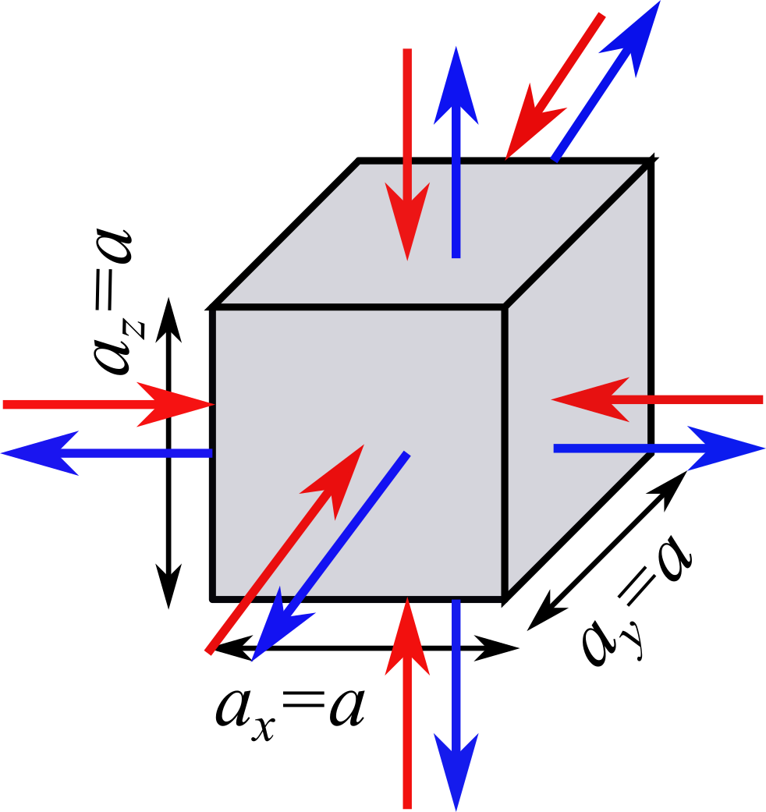
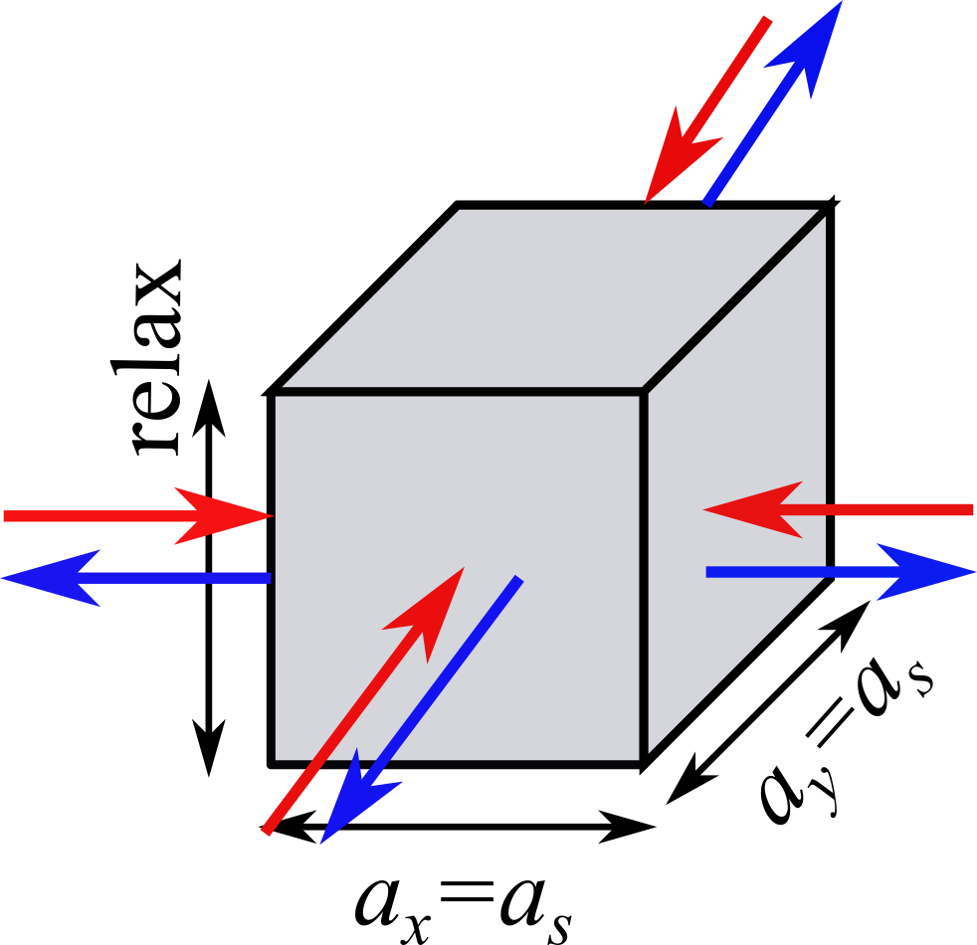
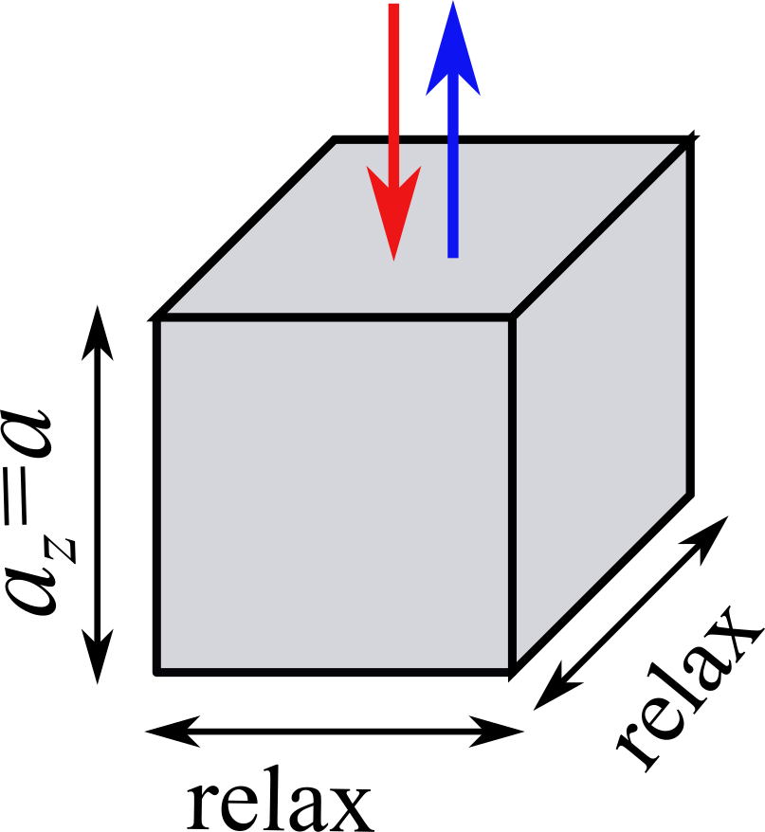
Approach
Computational details
Density functional theory
VASP
Geometry optimization: PBE + D3(BJ)
Electronic properties: TB09, SOC
Binary systems (e.g. GaAs): primitive cell
Ternary and quaternary systems (e.g. GaAsP): SQS (6 X 6 X 6)
Machine learning
Support vector machine-radial basis function kernel
isotropic strain
biaxial strain
uniaxial strain
P. Rosenow, L. C. Bannow, E. W. Fischer, W. Stolz, K. Volz, S. W. Koch, and R. Tonner,
Phys. Rev. B 97, 075201 (2018)

Slide 5
Predicting bandgap in strain-engineered binary III-V semiconductors
Chapter 1

Slide 6
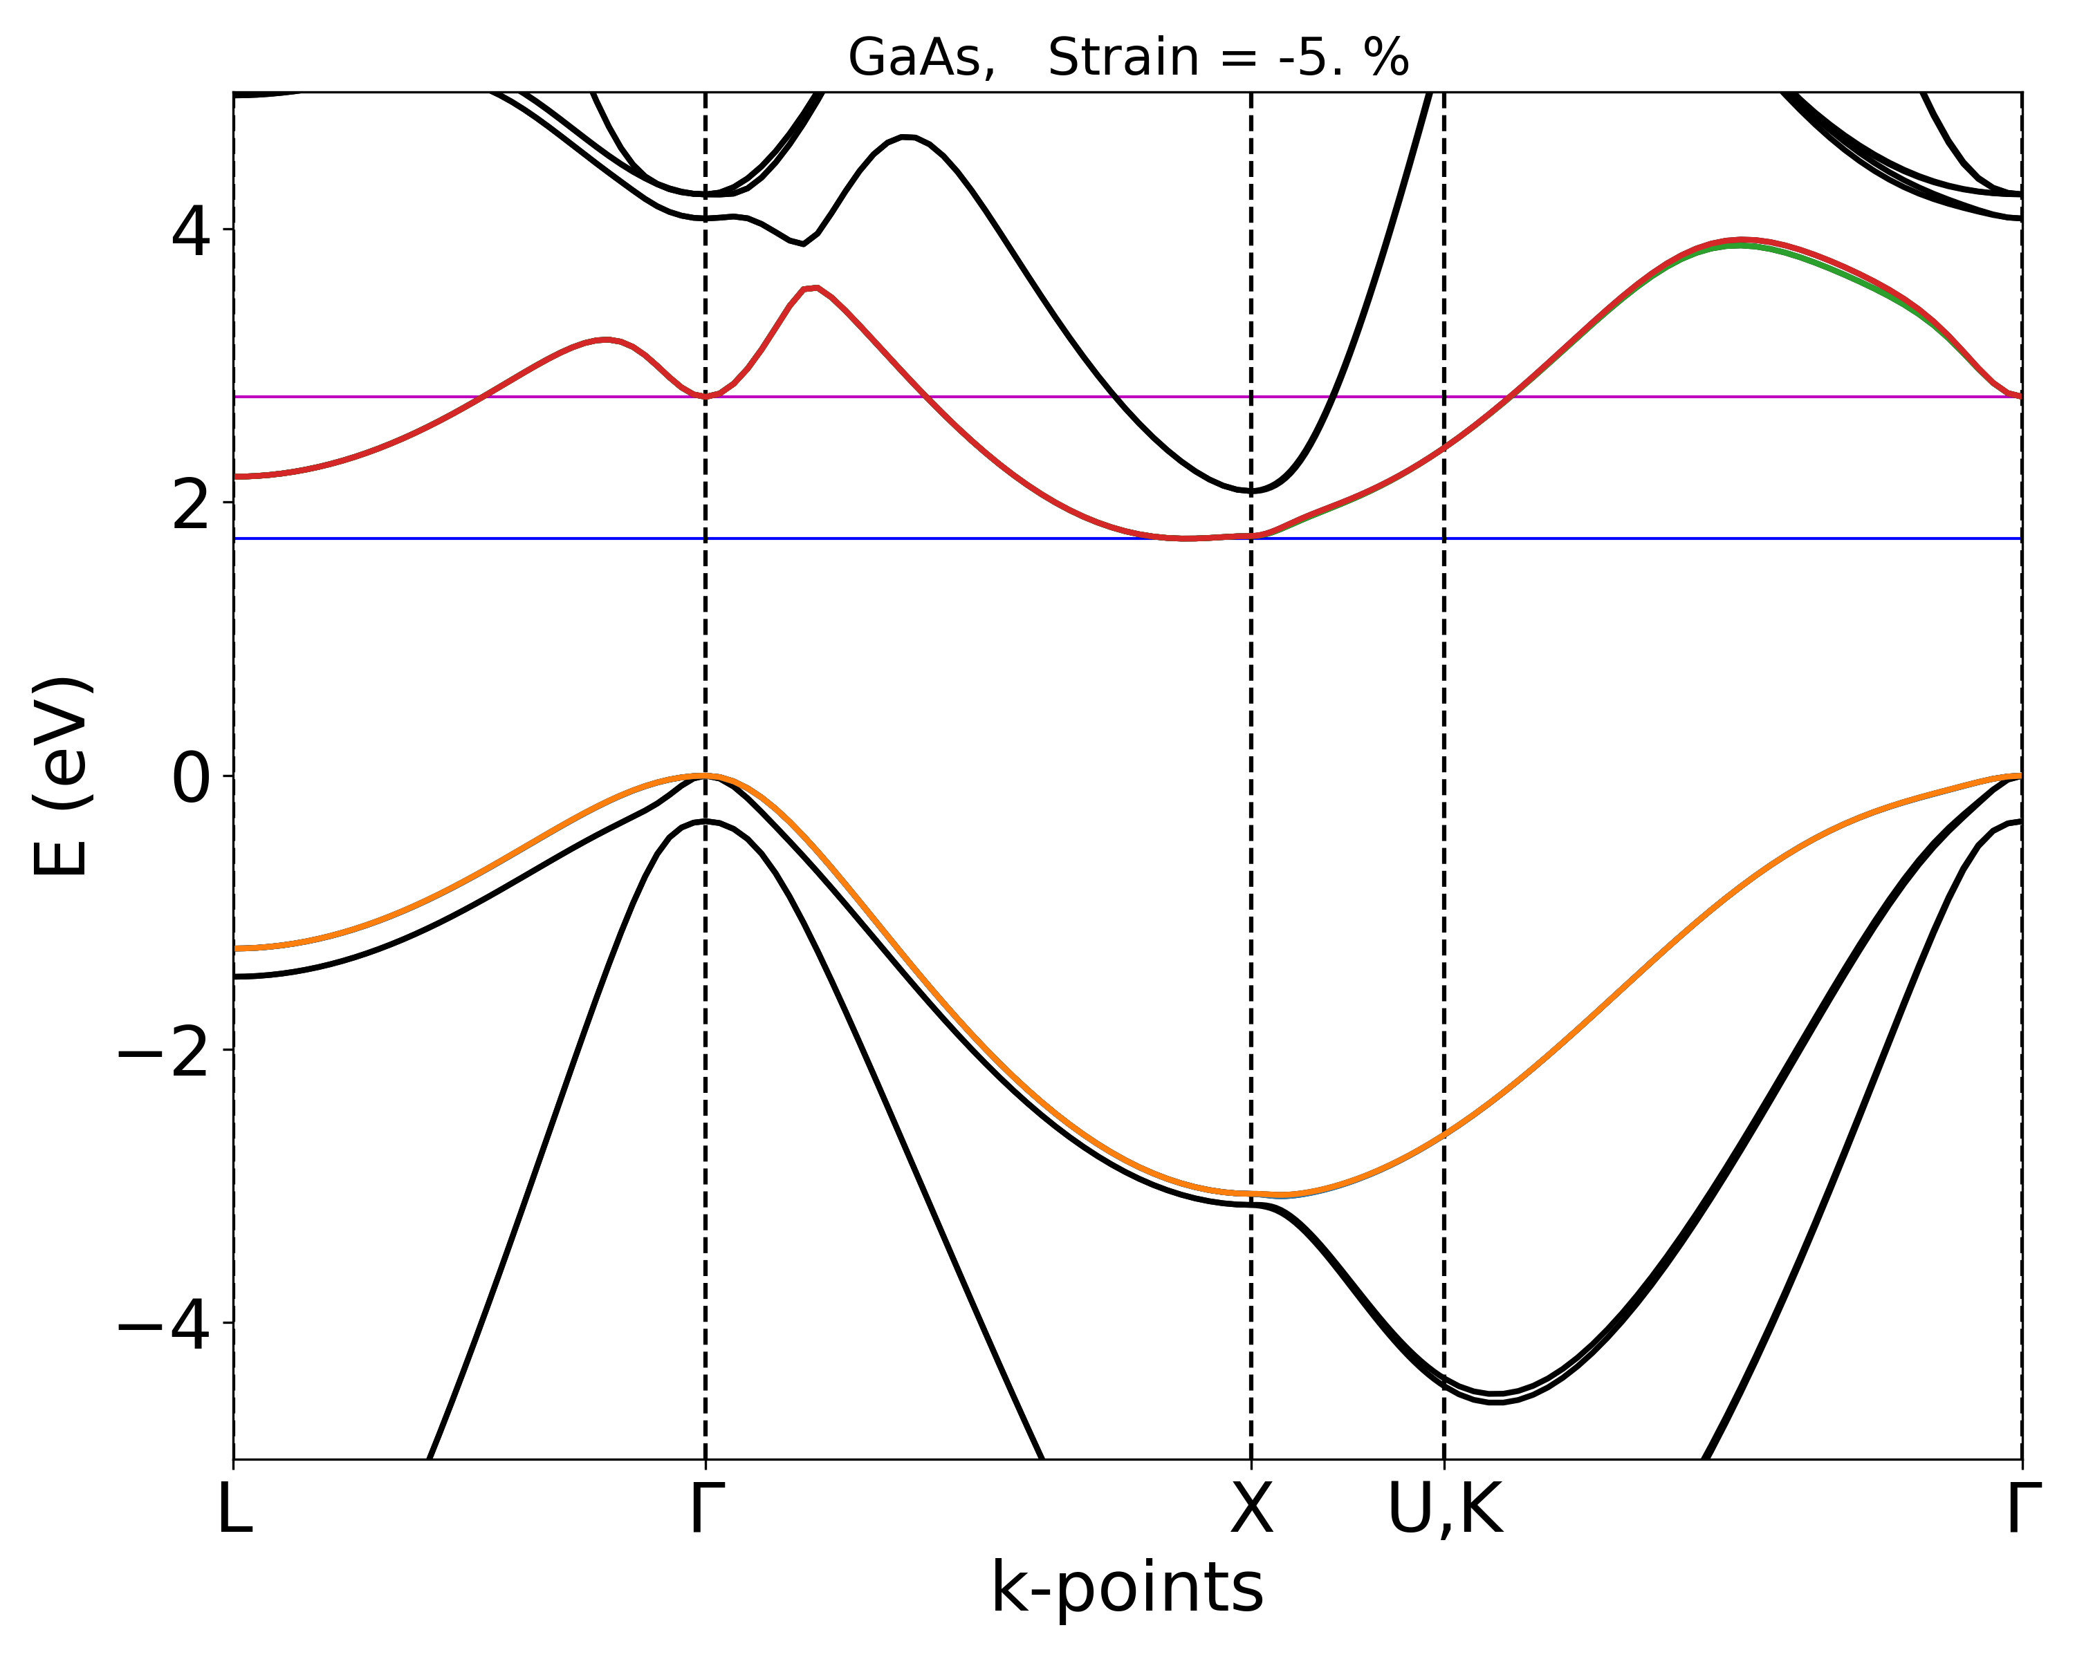
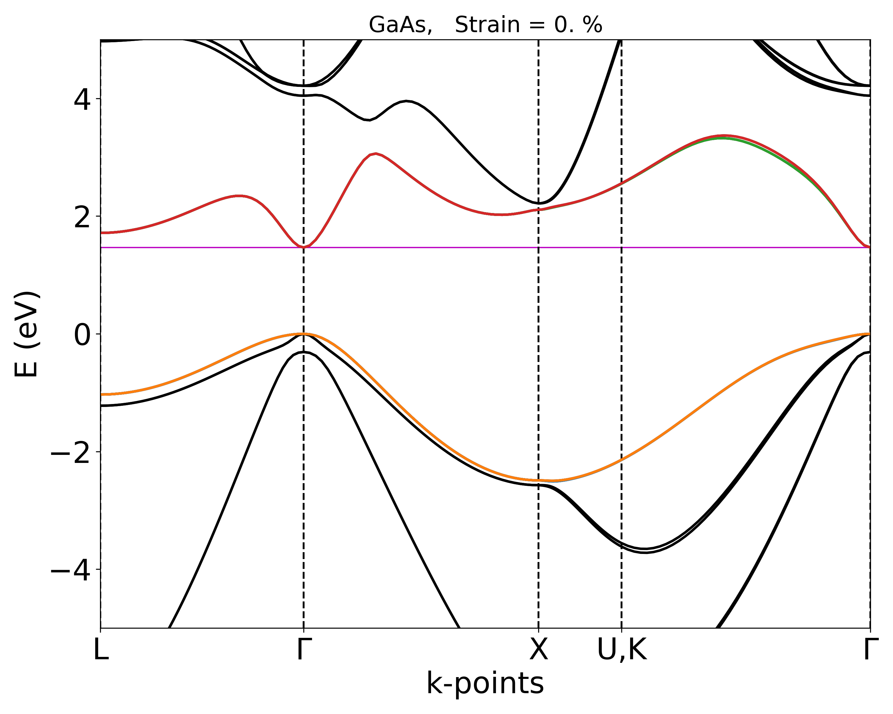
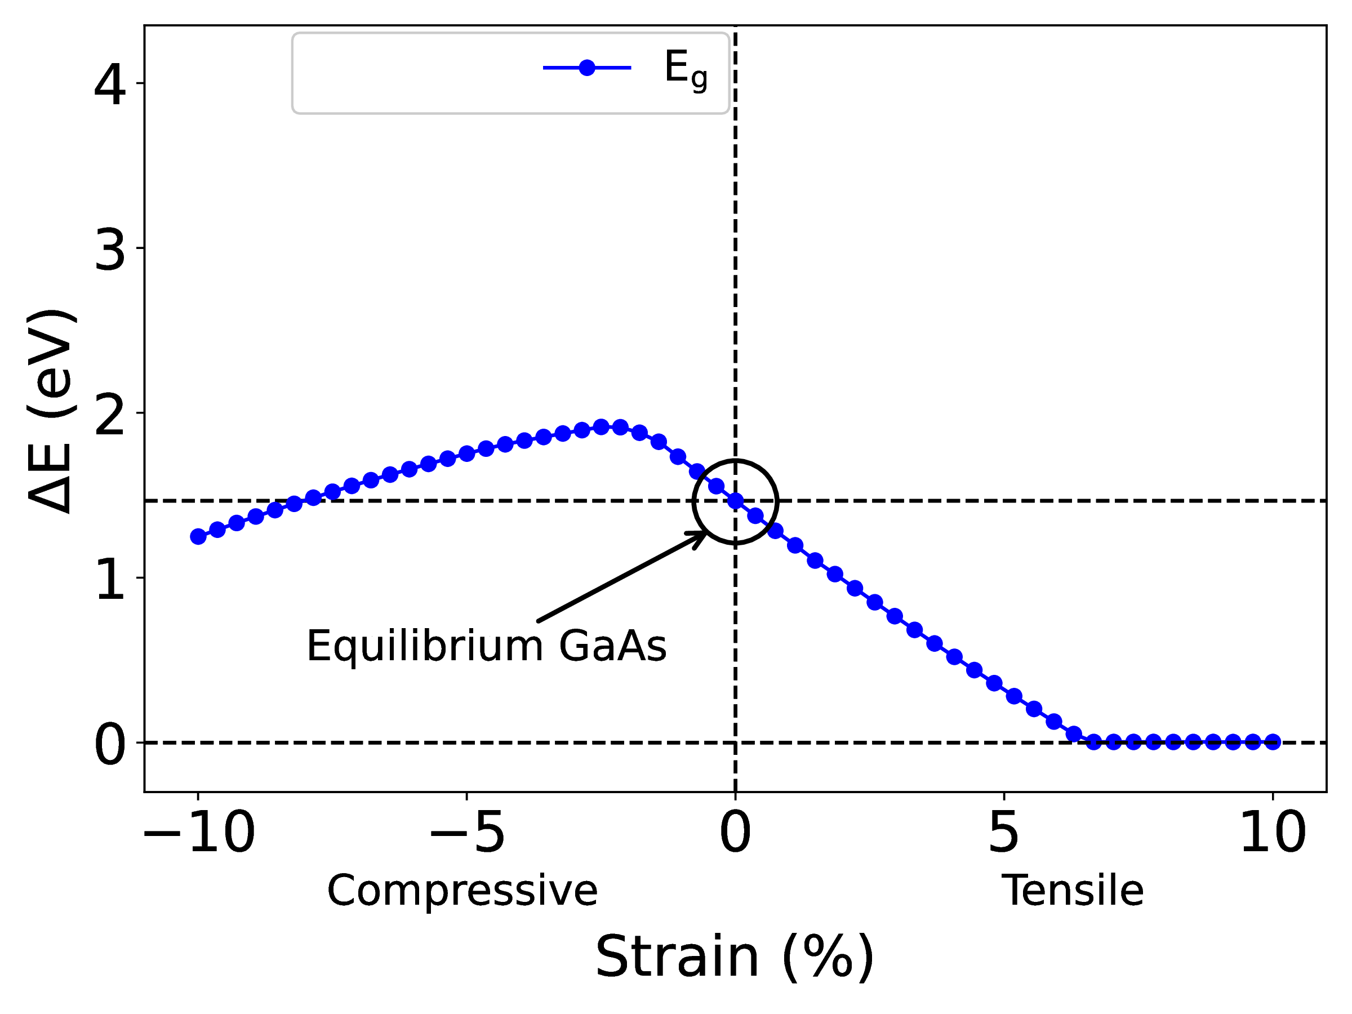
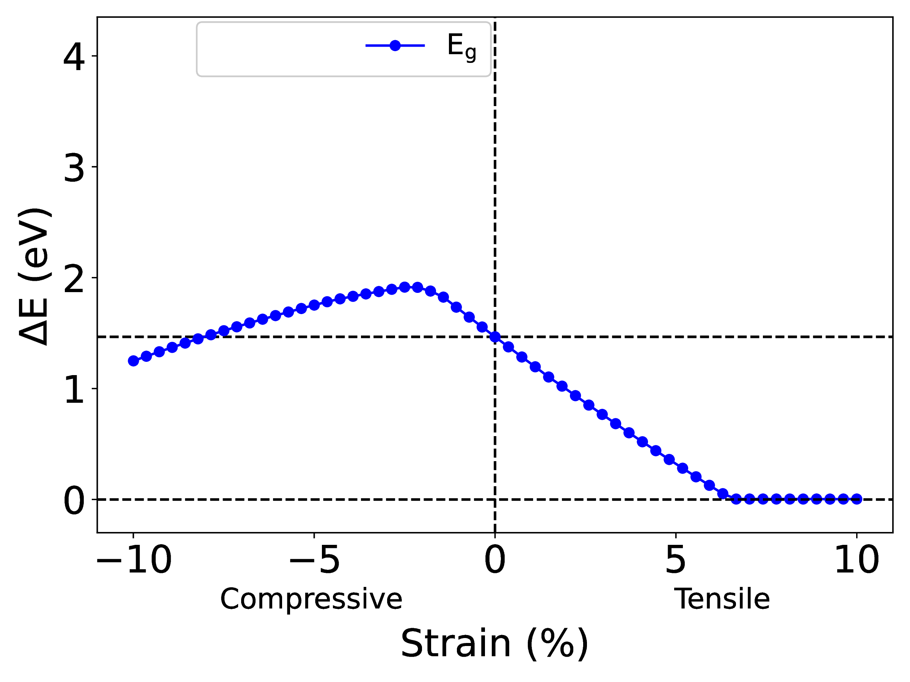
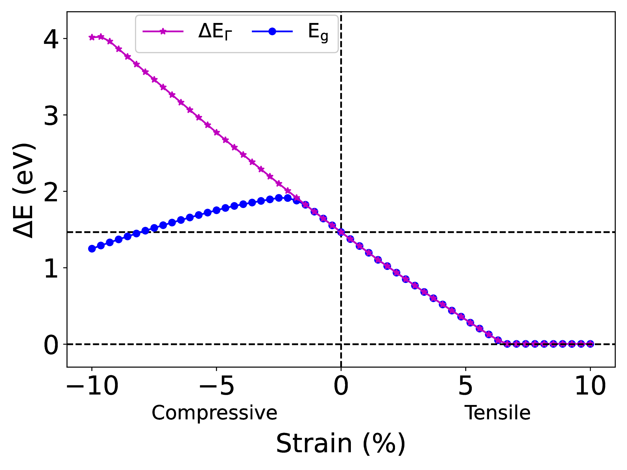
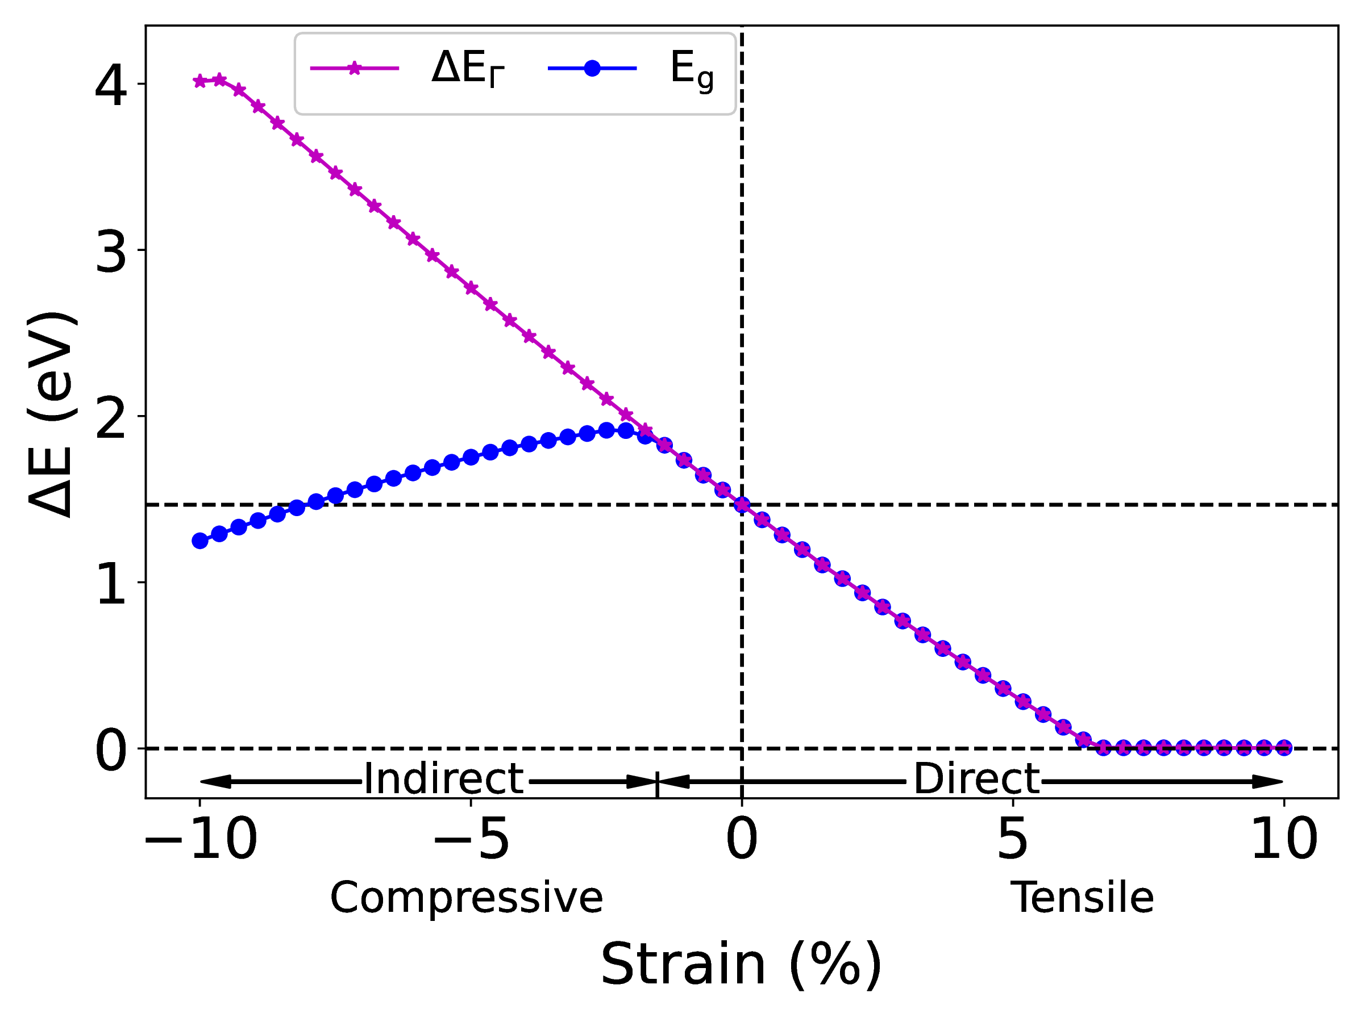
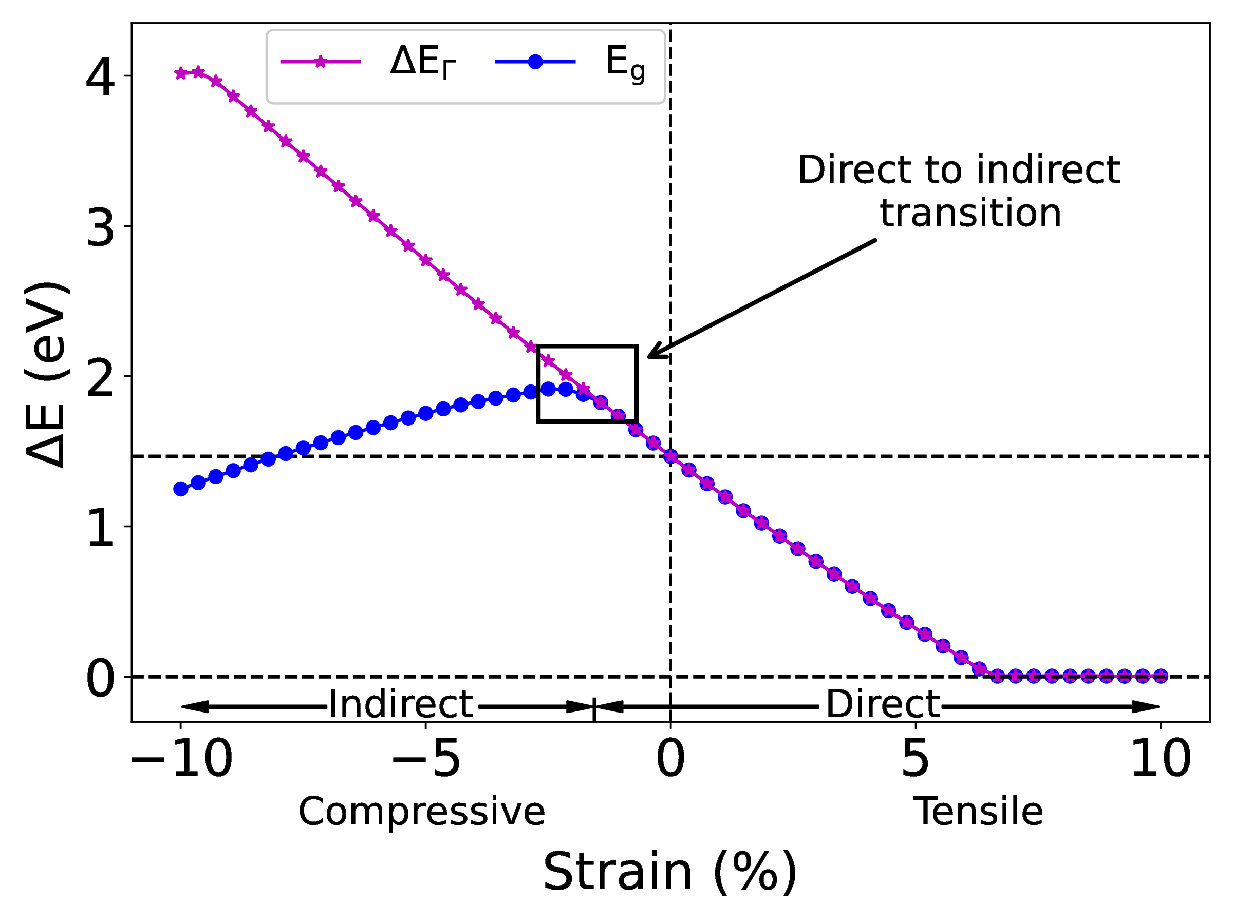
Binary III-V systems
Strain-bandgap relationship: GaAs isotropic strain
direct-indirect
transition
∆E_{Γ}
E_{g}
∆E_{Γ} = E_{g}
B. Mondal and R. Tonner-Zech, arXiv:2208.10596 (2022)

Slide 7
Predicting bandgap in strain-engineered ternary III-V semiconductors
Chapter 2

Slide 8
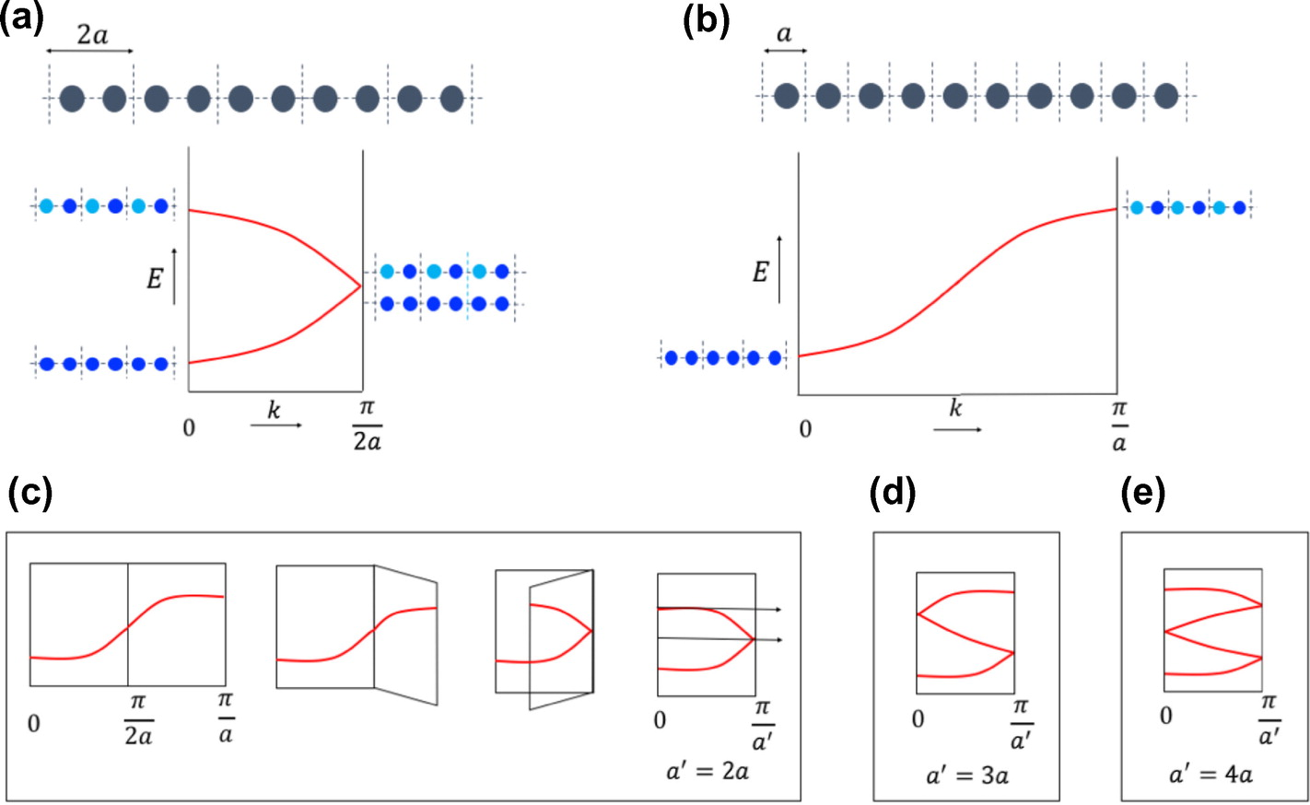
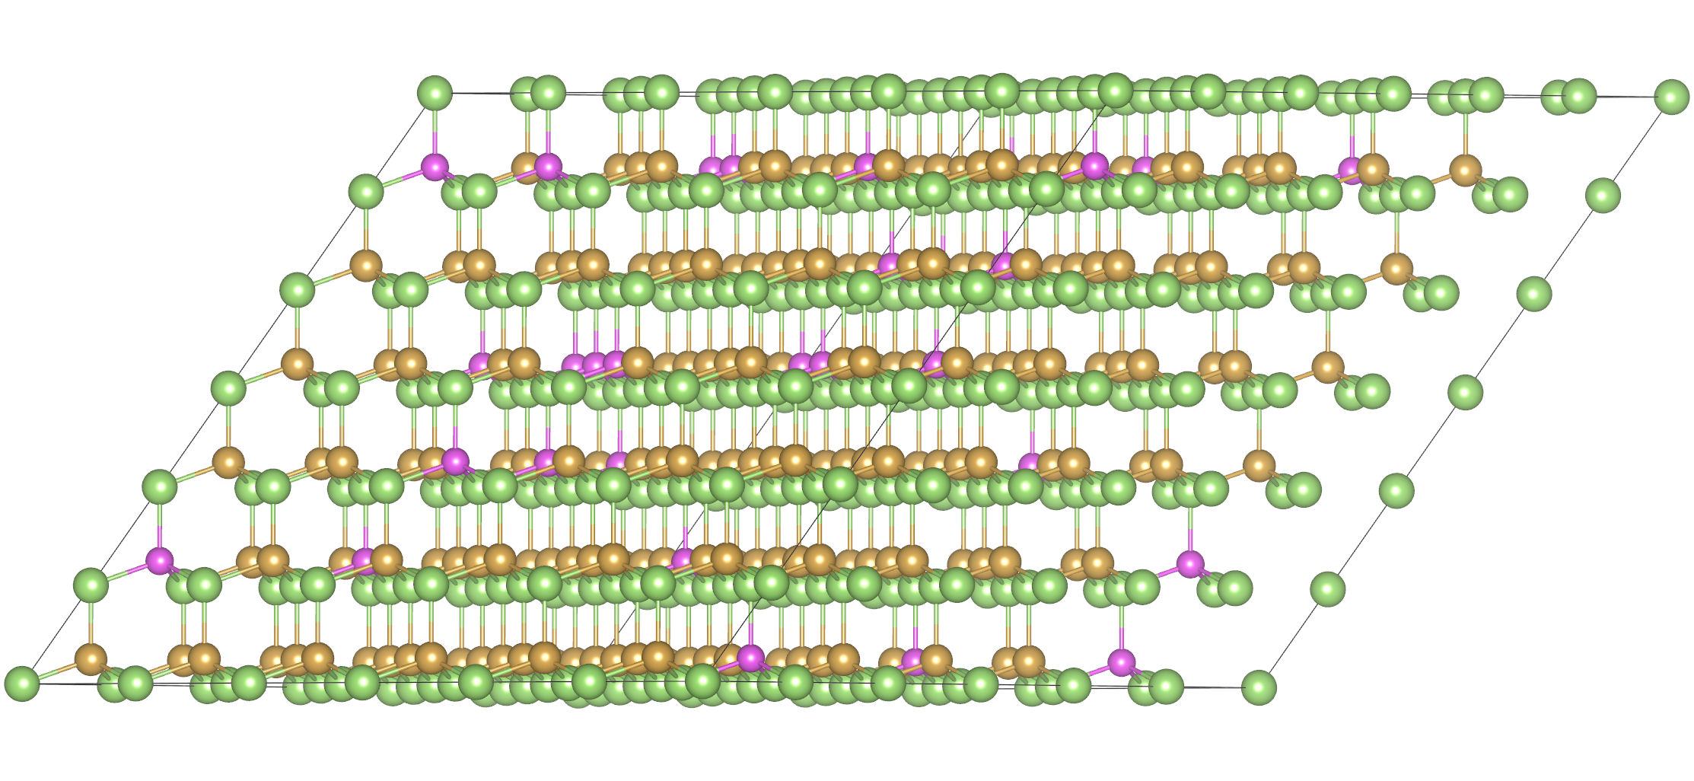
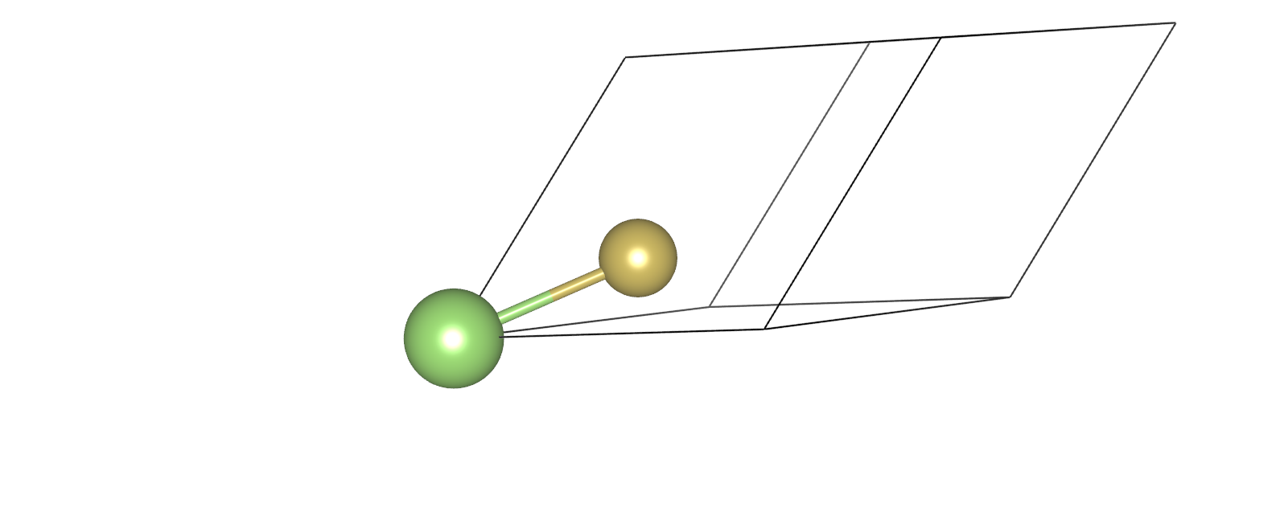
Ternary III-V systems
Composition-strain-bandgap: Ga(As1-xPx)
Challenges
Primitive cell
Supercell
Band folding
Bandgap magnitude
Bandgap nature?
*
Band unfolding
Bloch spectral weight*
$$ω_{Km}\left(k_{i}\right)=\sum_{n}{{\left|\left\langle Km | k_{i}n\right\rangle \right|}^{2}}$$
*S.-Y Yang et al., Adv. Phys:X 3, 1414631 (2018)
*V. Popescu, A. Zunger, Phys. Rev. b 85, 085201 (2012)

Slide 9
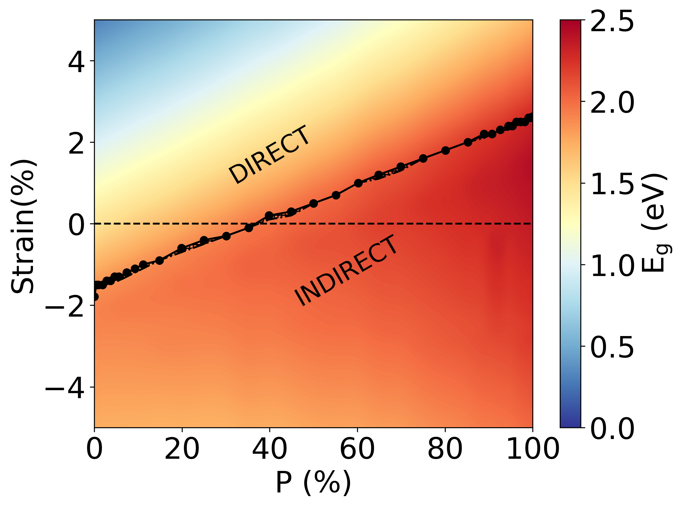
Ternary III-V systems
Bandgap phase diagram
Composition-strain-bandgap
Ga(AsP) isotropic strain
B. Mondal, M. Kröner, T. Hepp, K. Volz and R. Tonner-Zech, arXiv:2302.14547 (2023)

Slide 10
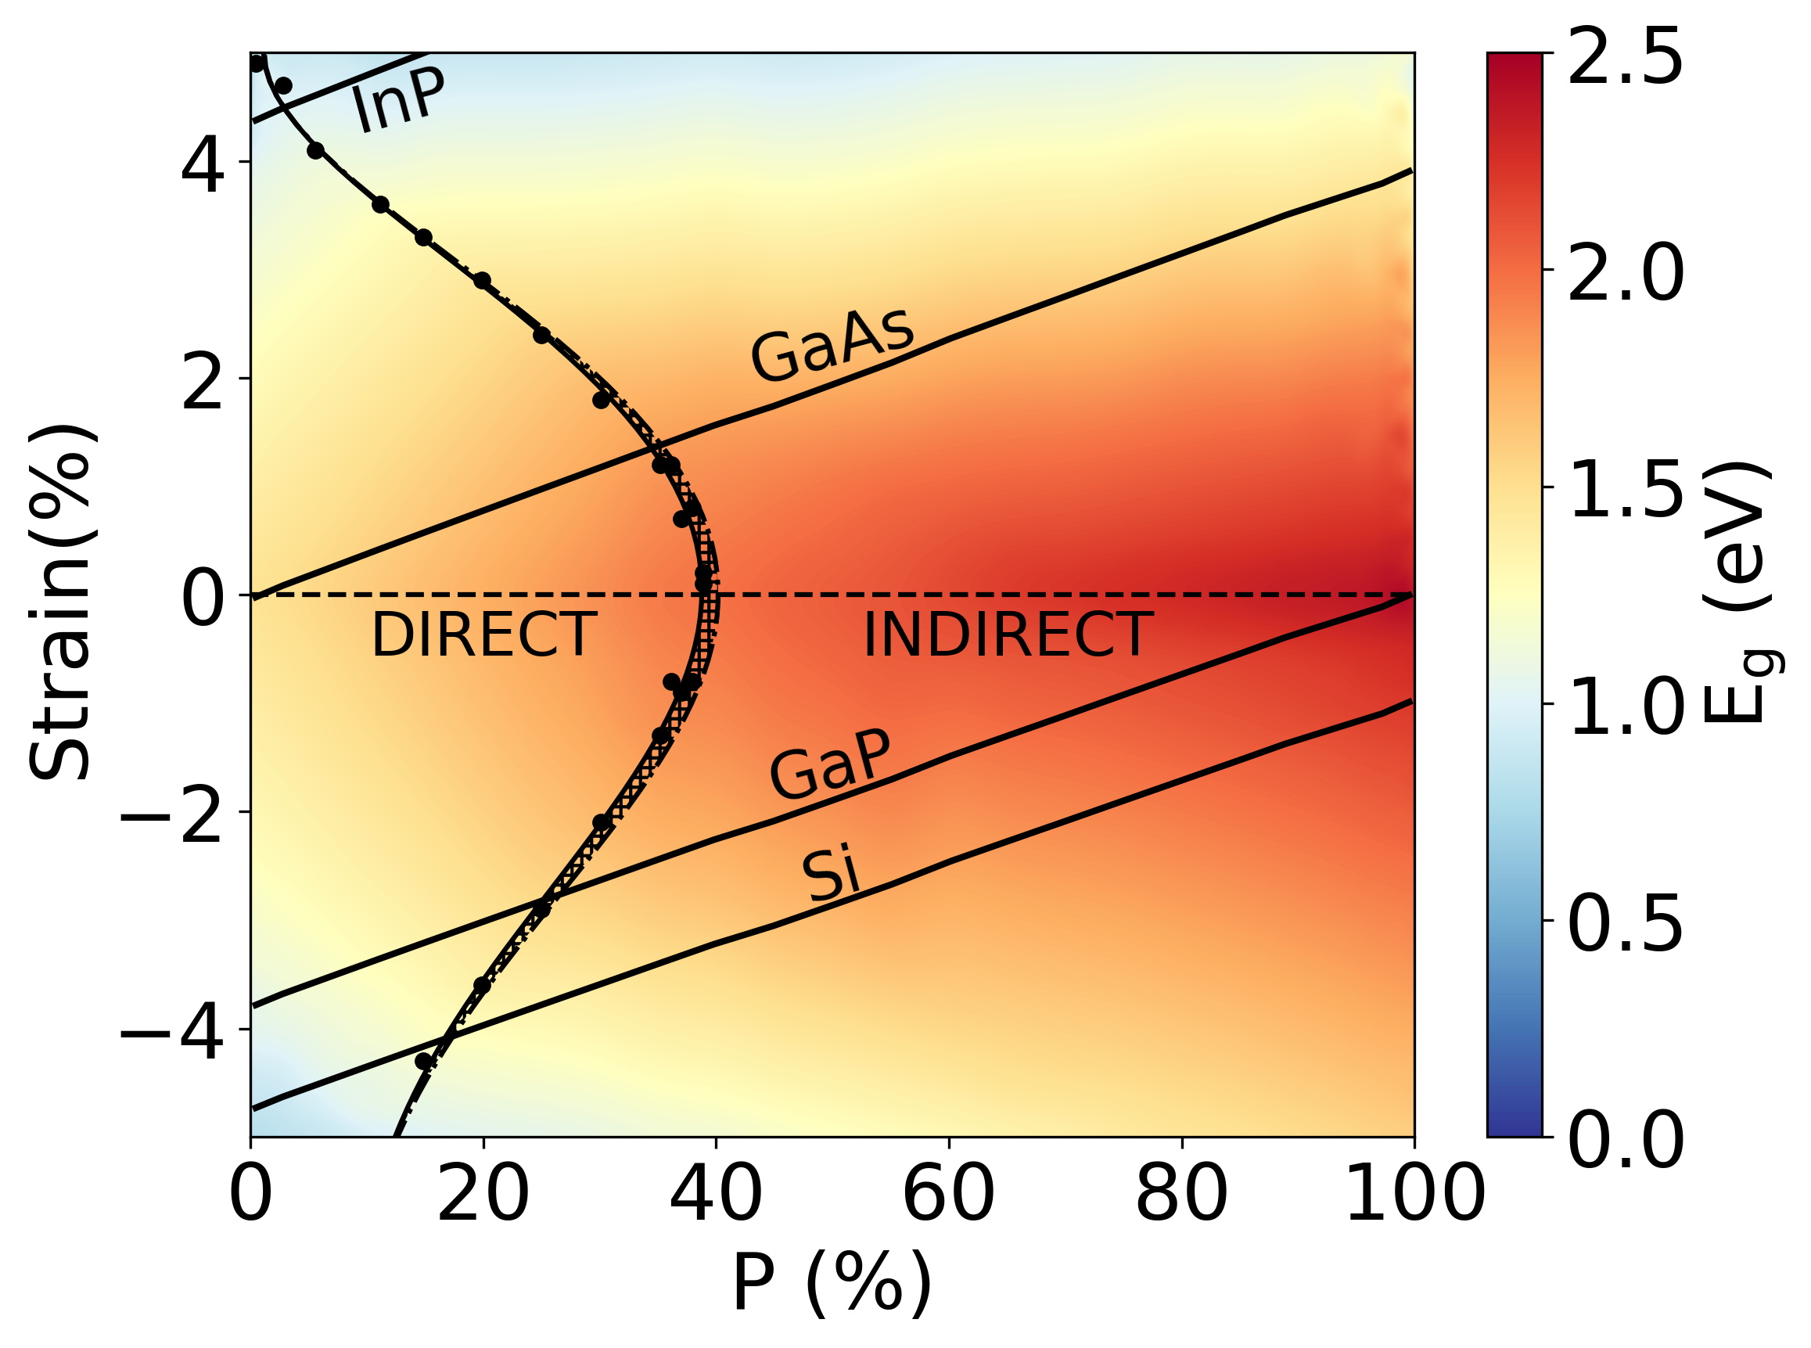
Ternary III-V systems
Bandgap phase diagram
Ga(AsP) biaxial strain
Substrate effect
B. Mondal, M. Kröner, T. Hepp, K. Volz and R. Tonner-Zech, arXiv:2302.14547 (2023)

Slide 11
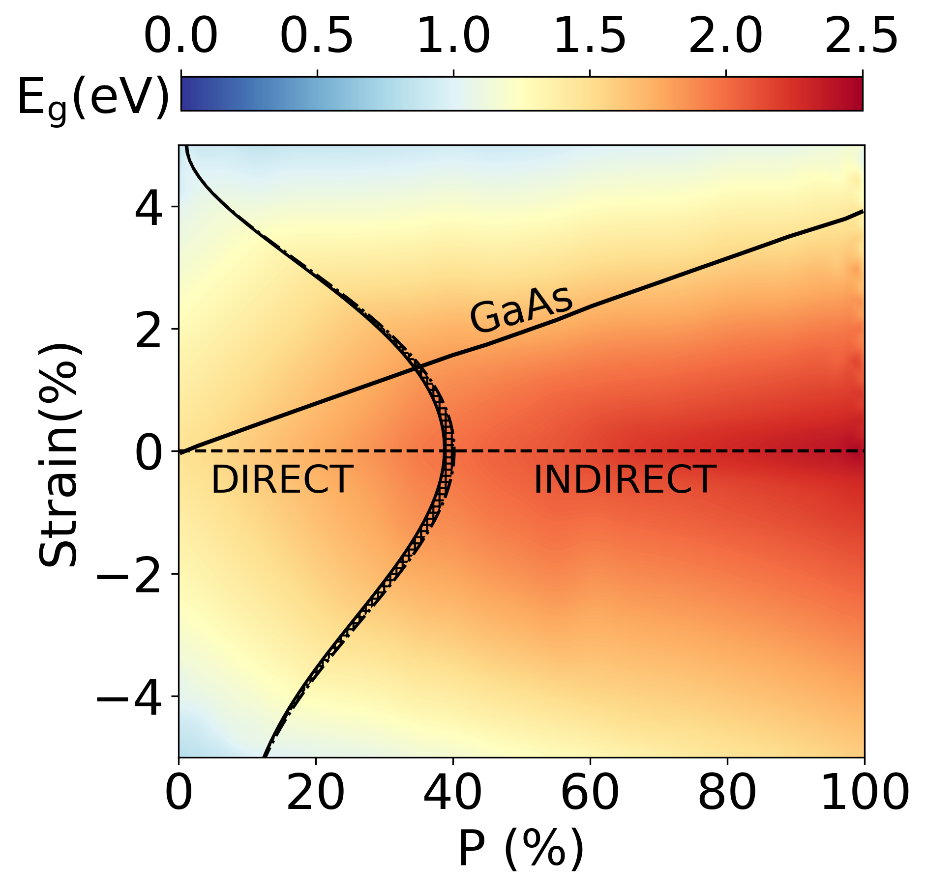
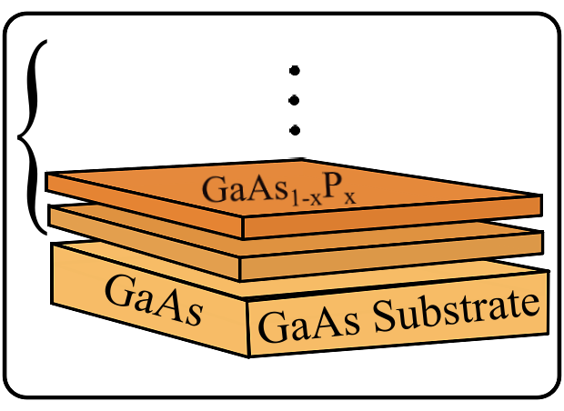
Ternary III-V systems
Bandgap phase diagram: Ga(AsP) biaxial strain
direct bandgap
B. Mondal, M. Kröner, T. Hepp, K. Volz and R. Tonner-Zech, arXiv:2302.14547 (2023)

Slide 12
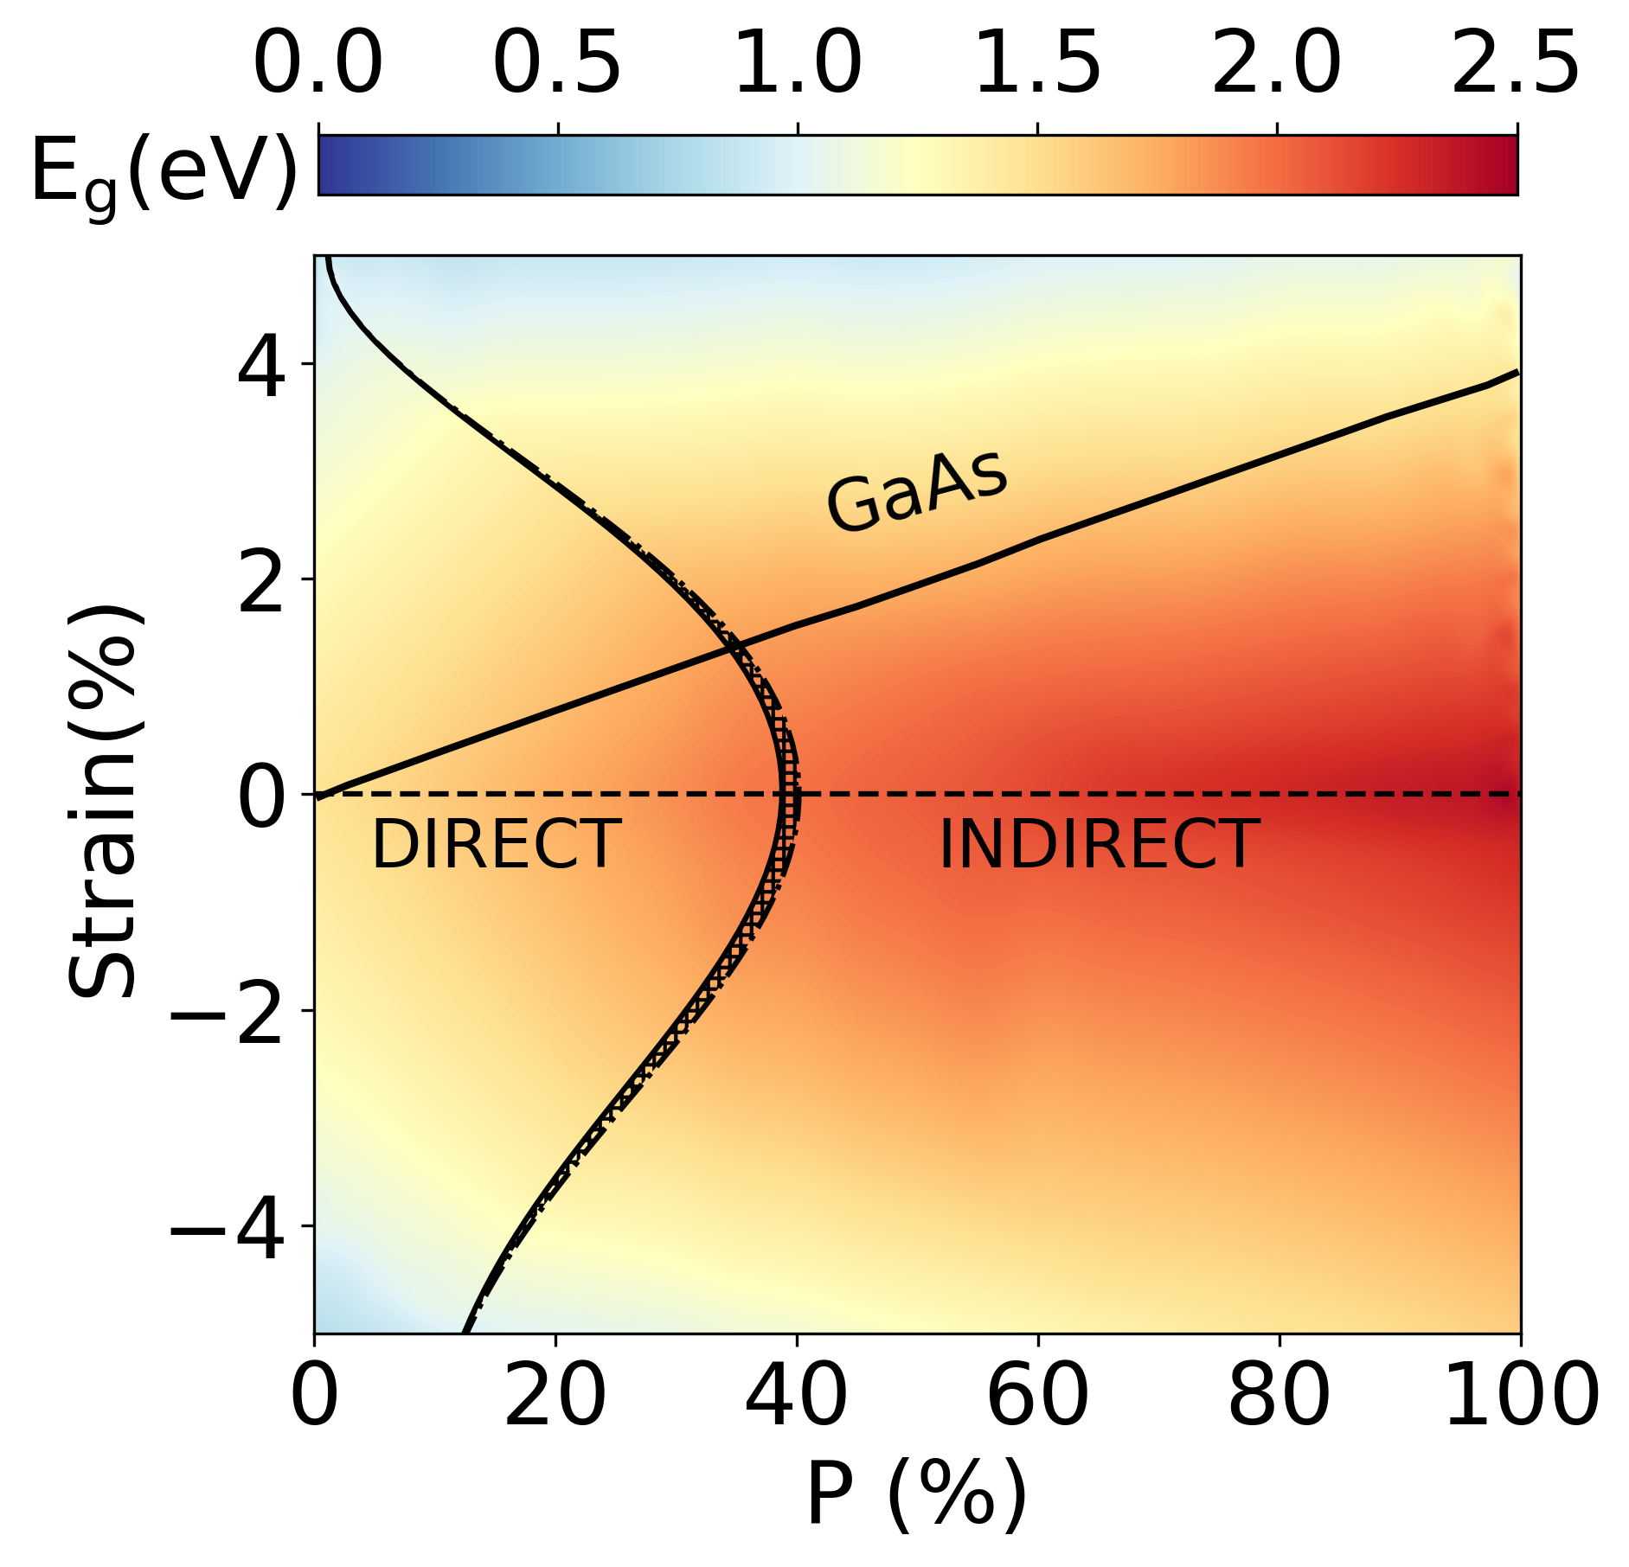
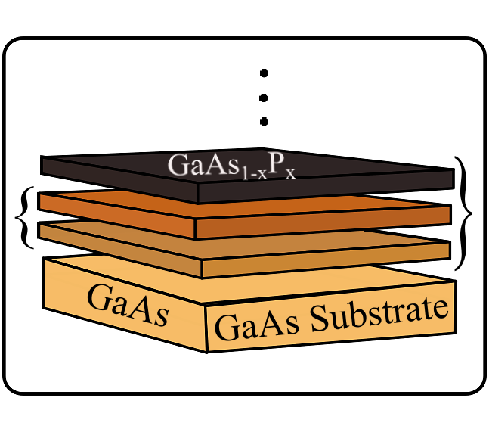
Ternary III-V systems
Bandgap phase diagram: Ga(AsP) biaxial strain
indirect bandgap
direct bandgap
B. Mondal, M. Kröner, T. Hepp, K. Volz and R. Tonner-Zech, arXiv:2302.14547 (2023)

Slide 13
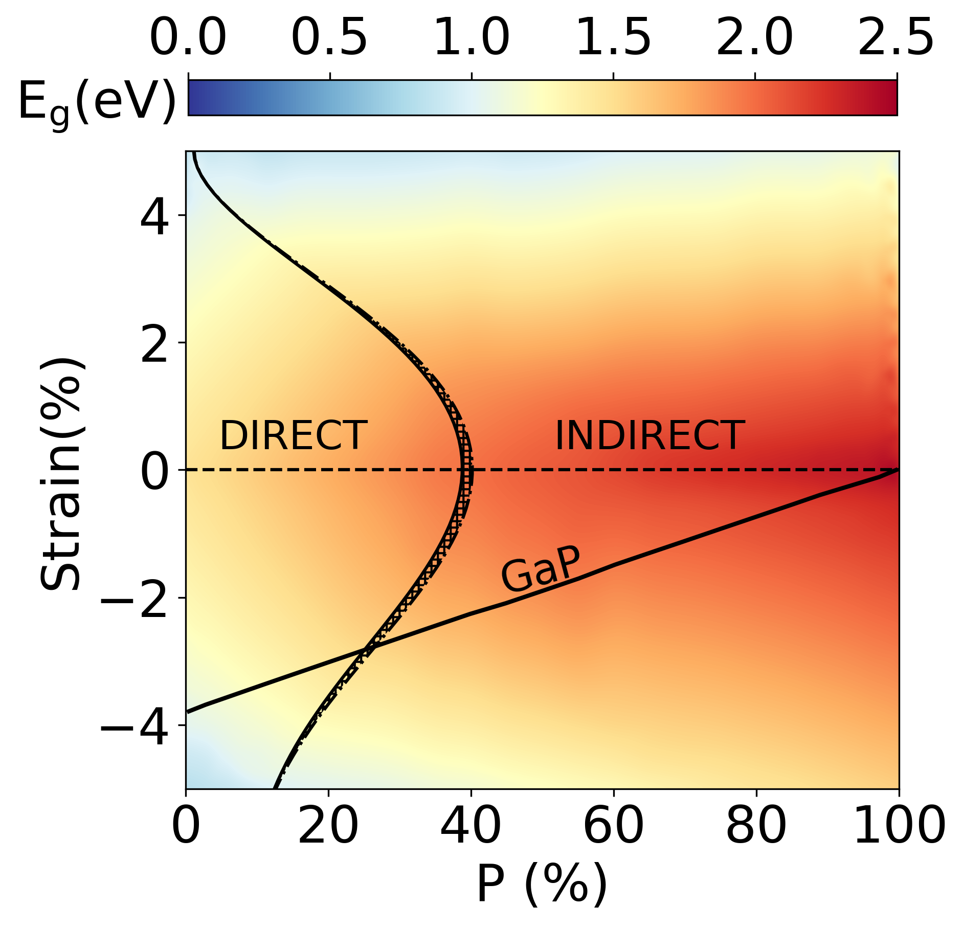
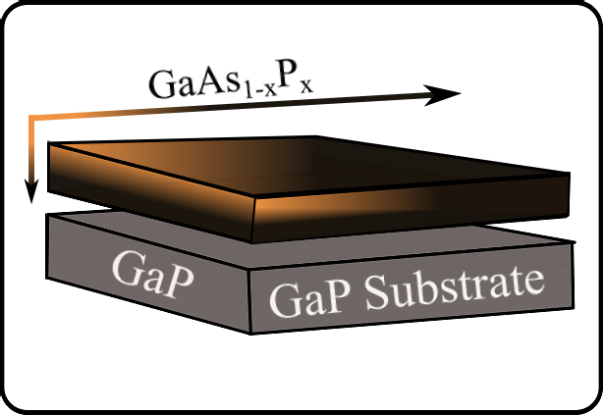
Ternary III-V systems
Bandgap phase diagram: Ga(AsP) biaxial strain
B. Mondal, M. Kröner, T. Hepp, K. Volz and R. Tonner-Zech, arXiv:2302.14547 (2023)

Slide 14
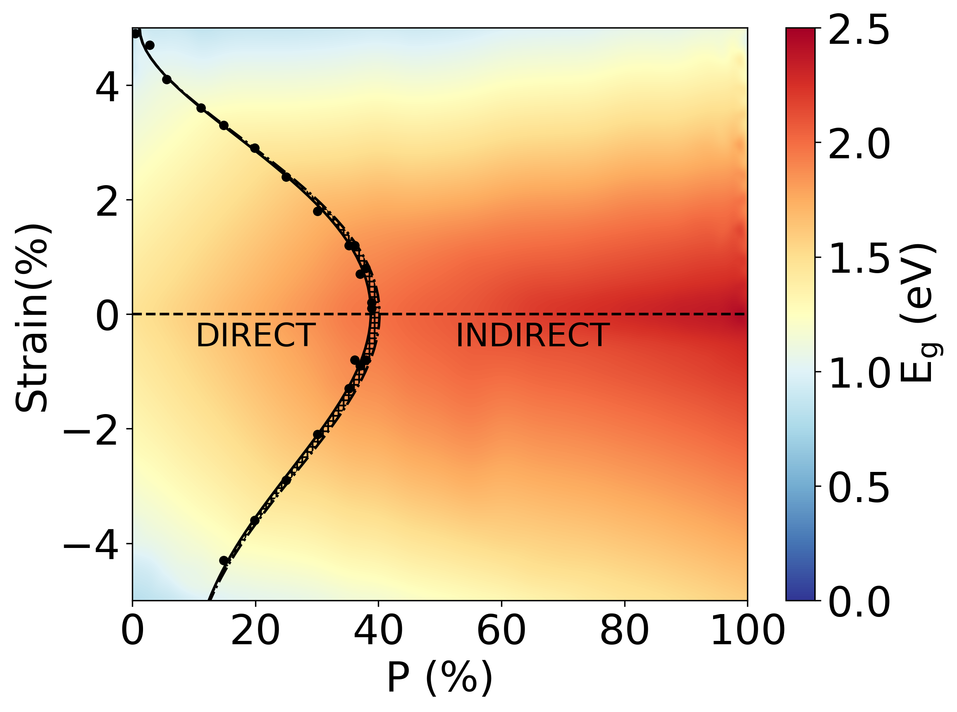
Paradigm shift: DFT → DFT-ML
Accelerated mapping

Slide 15
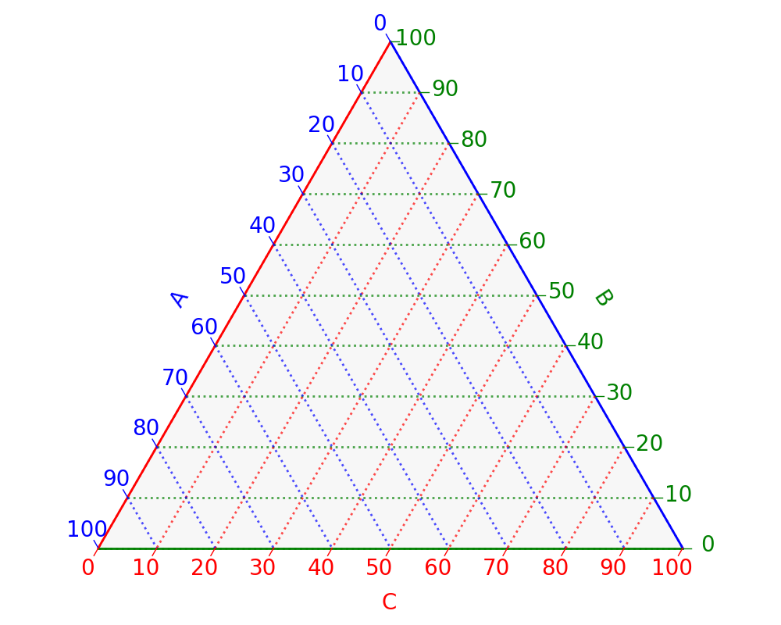
Paradigm shift: DFT → DFT-ML
Accelerated mapping
estimated required
# of DFT calculations
2,000
500,000
Strain=0

Slide 16
Paradigm shift: DFT → DFT-ML
Accelerated mapping
Training
Training
Predictions

Slide 17
Predicting bandgap in strain-engineered quaternary III-V semiconductors
Chapter 3

Slide 18
Quaternary III-V systems
Bandgap phase diagram
Machine learning model
Supervised learning
Support vector machine
Radial basis function kernel
Features: composition, strain
Labels: bandgap (magnitude, nature)
B. Mondal, J. Westermayr and R. Tonner-Zech, in preparation

Slide 19
Quaternary III-V systems
Bandgap phase diagram
Supervised machine learning
SVM-RBF
composition, strain, bandgap
Training ($+$testing) set: 4000 points
Strain range: $±$5%
Prediction accuracy
RMSE in bandgap values: 47 ($±$1) meV
Accuracy in bandgap nature: 95 ($±$1) %
Ga(AsPSb) biaxial strain
B. Mondal, J. Westermayr and R. Tonner-Zech, in preparation

Slide 20
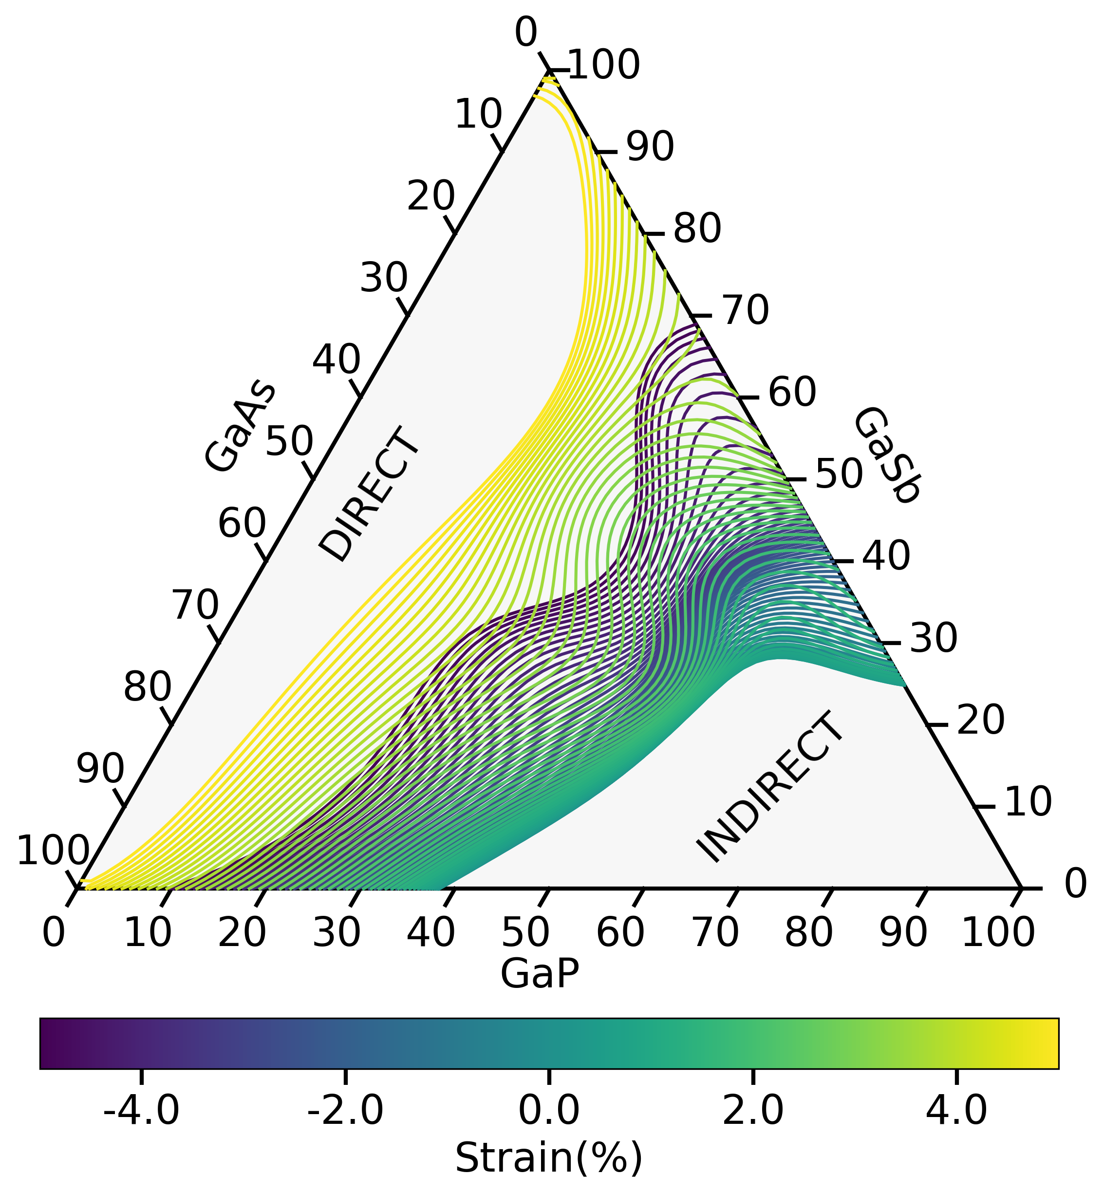
Quaternary III-V systems
direct-indirect transition
tensile
Bandgap phase diagram
no direct-indirect transition
direct-indirect transition
compressive + tensile
Supervised machine learning
SVM-RBF
composition, strain, bandgap
Training ($+$testing) set: 4000 points
Strain range: $±$5%
Prediction accuracy
RMSE in bandgap values: 47 ($±$1) meV
Accuracy in bandgap nature: 95 ($±$1) %
Ga(AsPSb) biaxial strain
B. Mondal, J. Westermayr and R. Tonner-Zech, in preparation

Slide 21
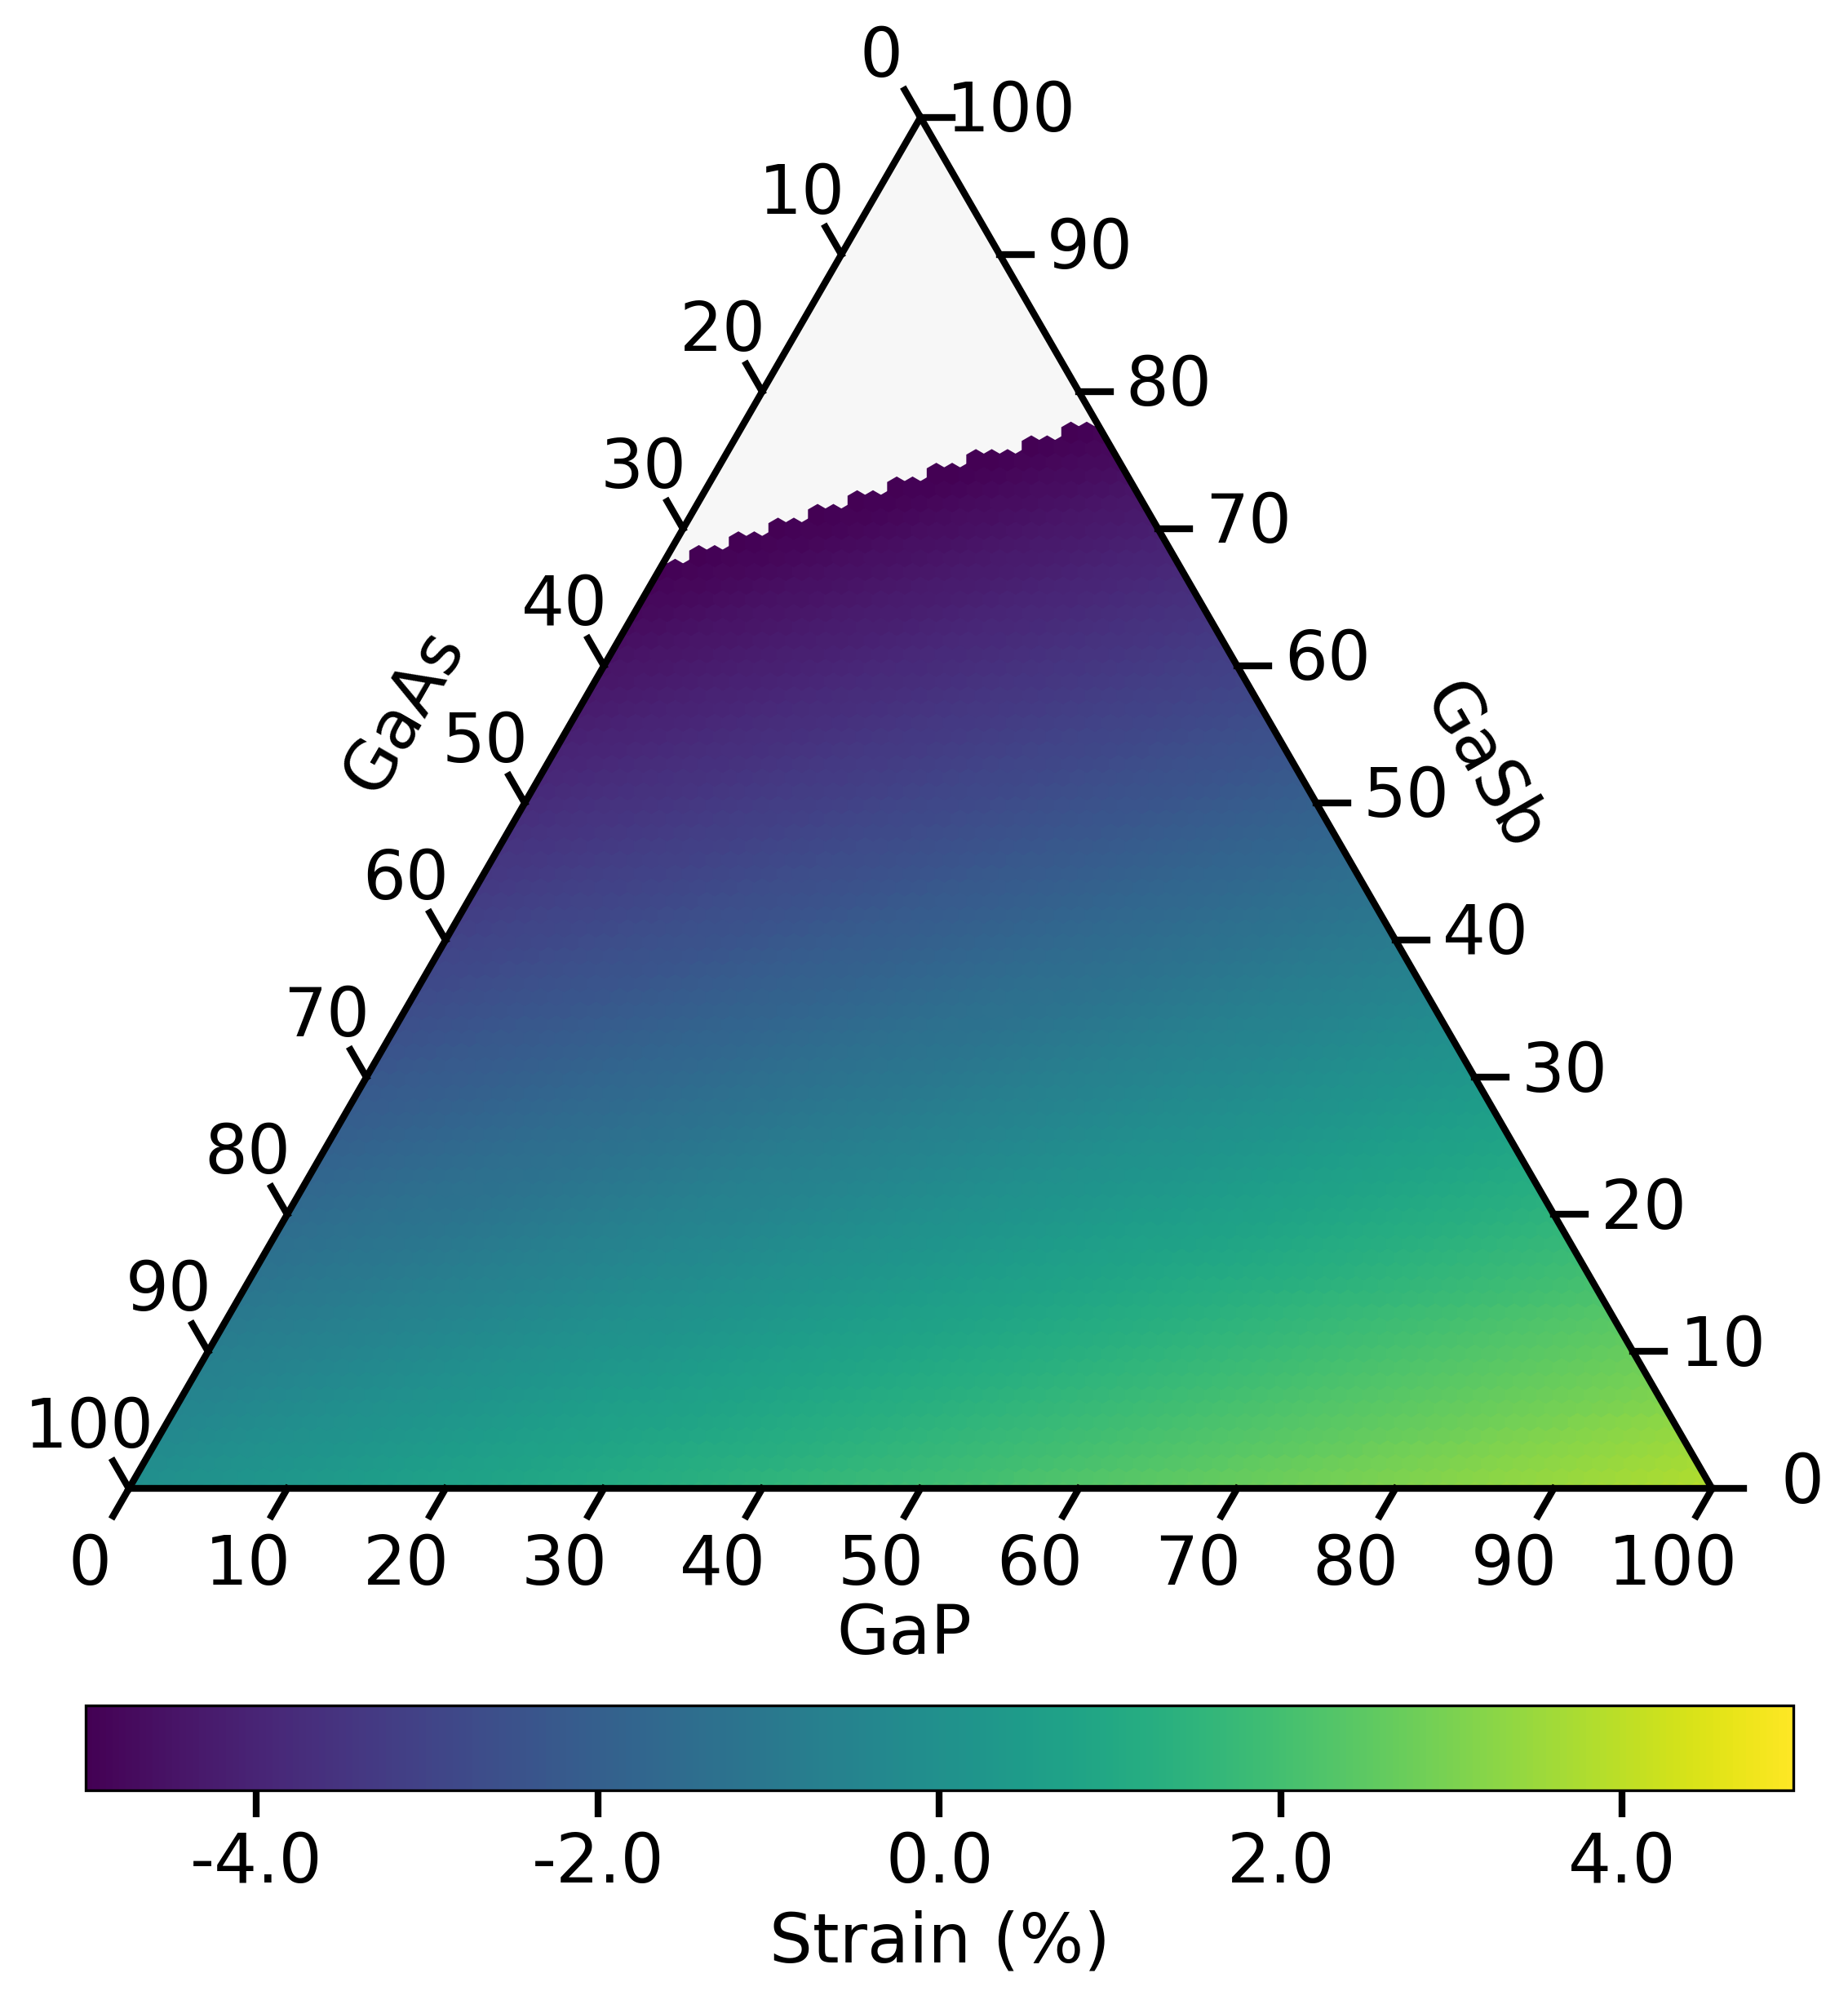
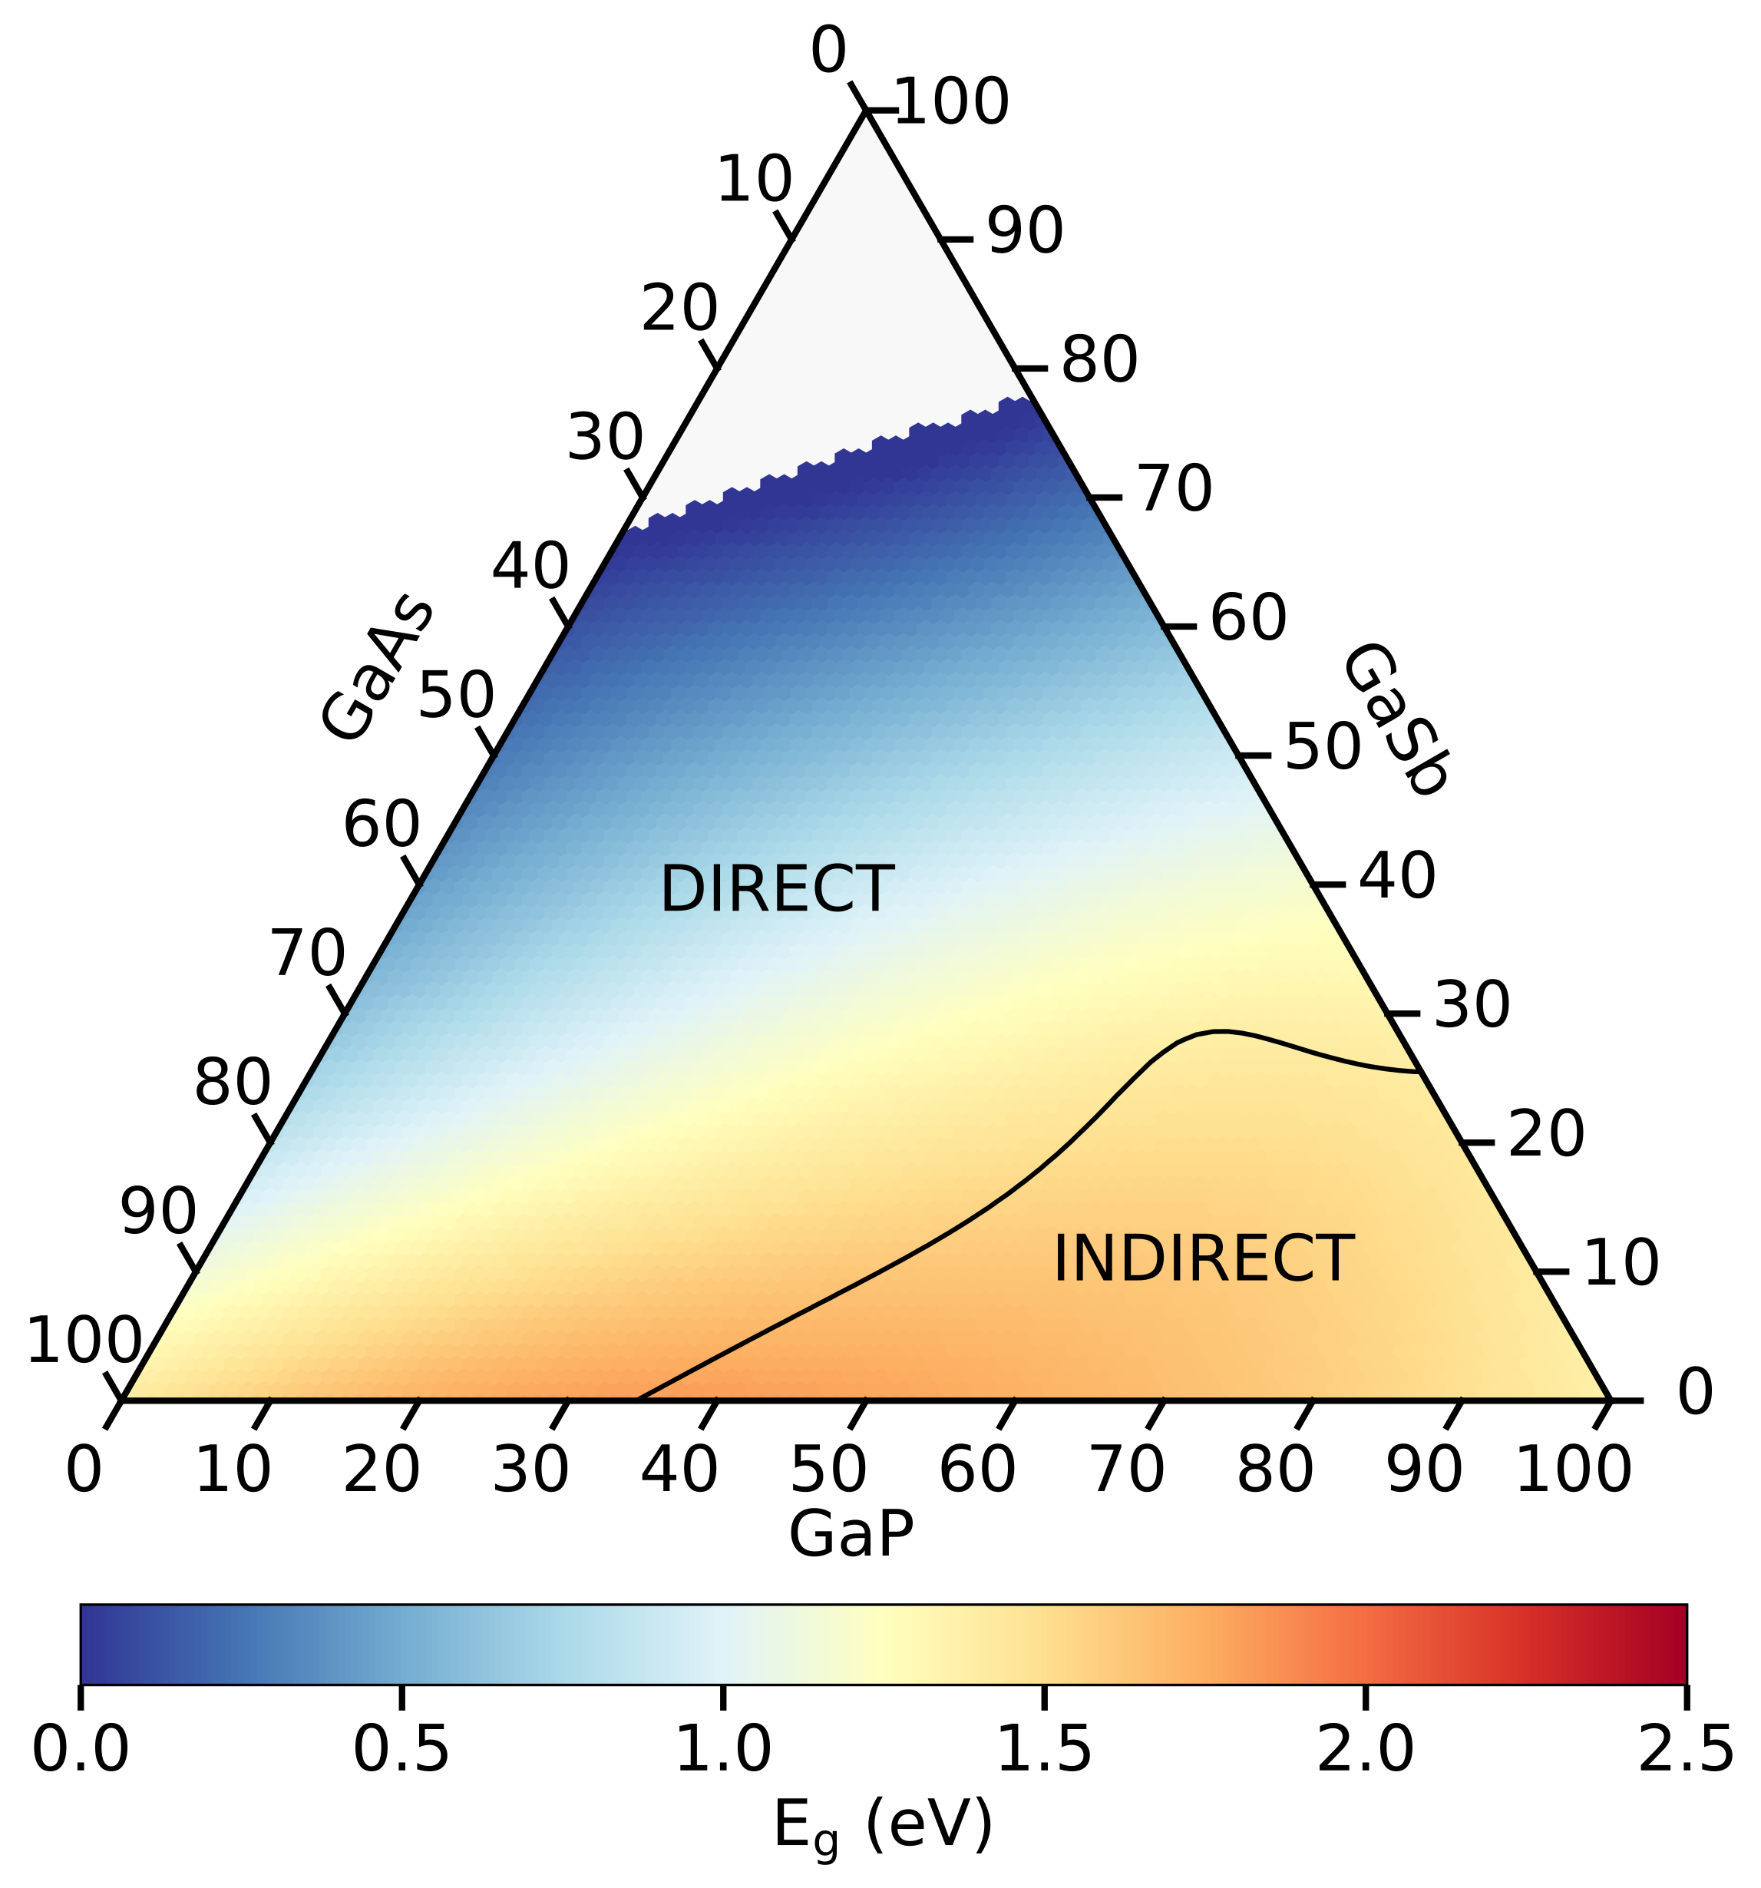
Quaternary III-V systems
Bandgap phase diagram: Ga(AsPSb) substrate effect
Ga(AsPSb)/GaAs
B. Mondal, J. Westermayr and R. Tonner-Zech, in preparation

Slide 22
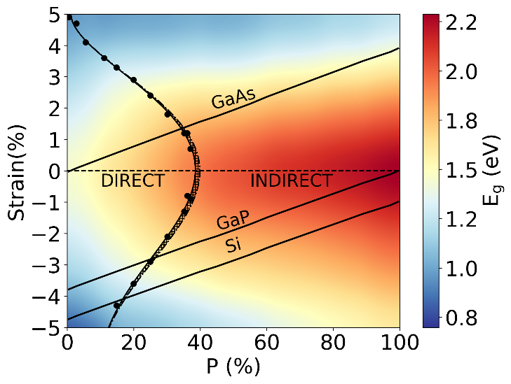
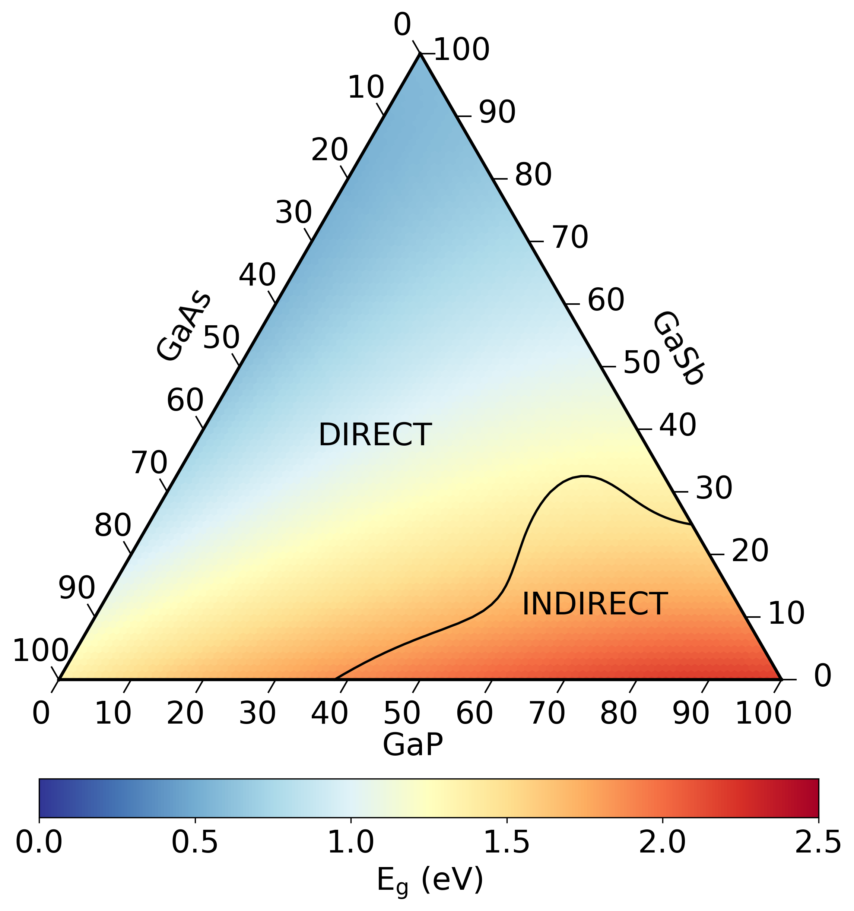
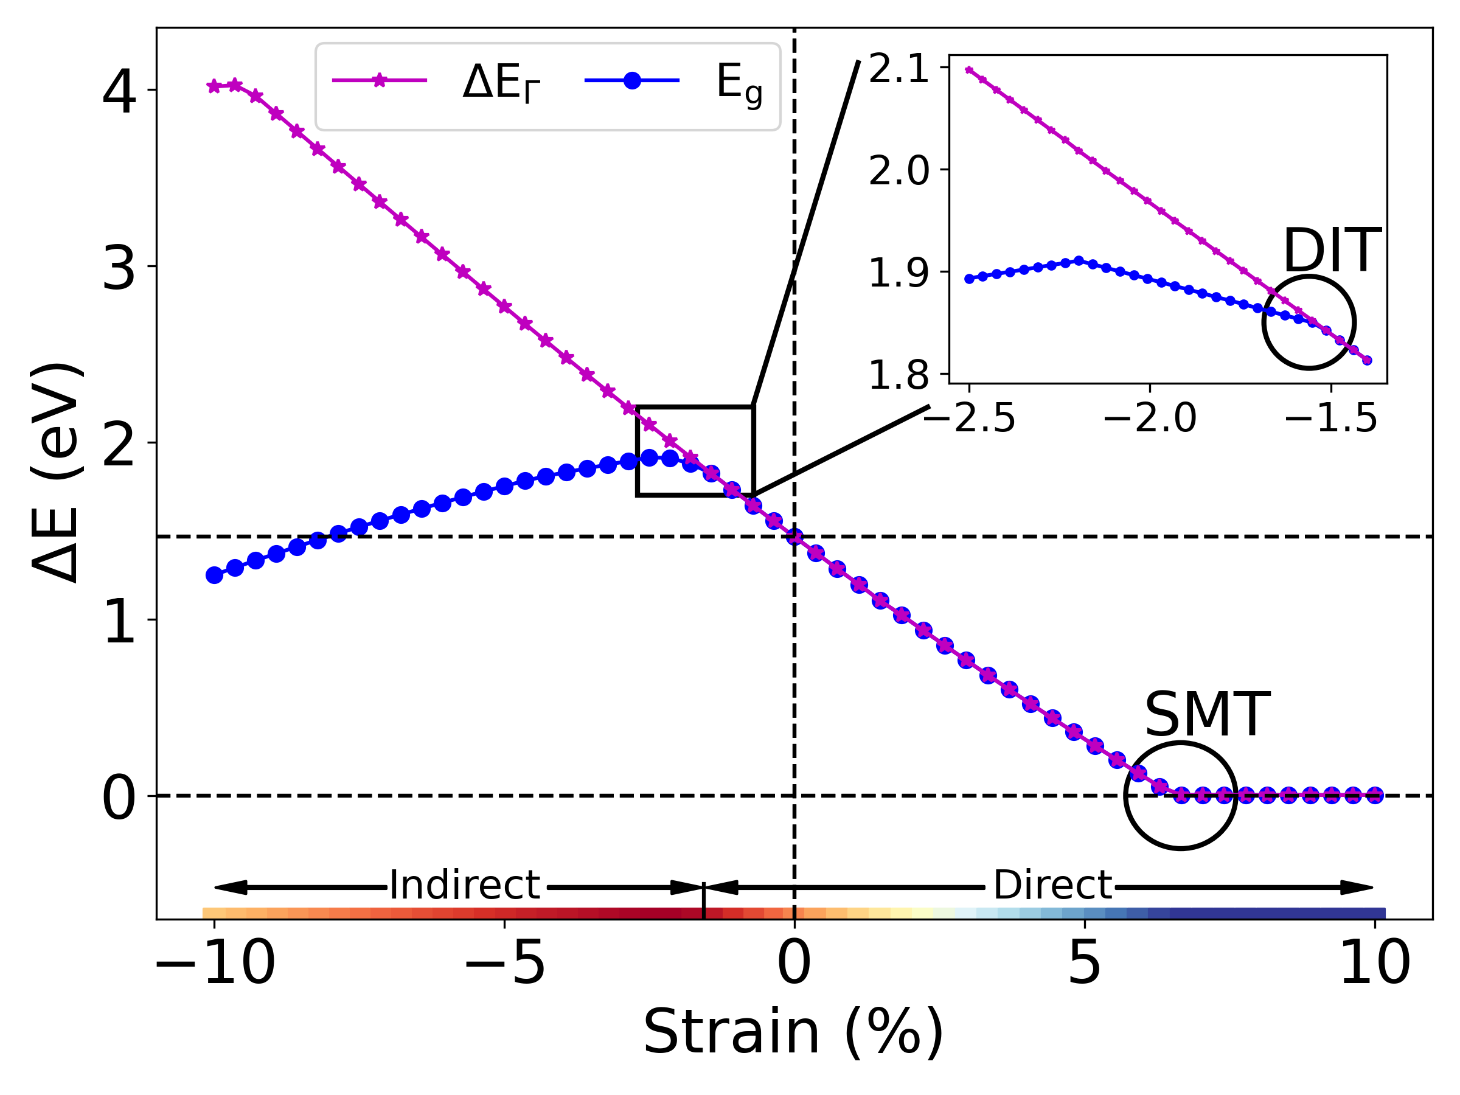
Summary
direct-indirect
transition
Band unfolding
Machine learning
Binary
Ternary
Quaternary
Strain-induced direct-indirect bandgap transition
Predictive composition-strain-bandgap mapping
Bandgap phase diagram
Machine learning accelerated bandgap phase diagram
https://bmondal94.github.io/Bandgap-Phase-Diagram (find in contribution abstract)

Slide 23
Acknowledgements
HRZ | Hochschulrechenzentrum
Prof. Dr. Ralf Tonner-Zech
Prof. Dr. Julia Westermayr
Prof. Dr. Kerstin Volz
Marcel Kröner
Thilo Hepp
https://bmondal94.github.io/Bandgap-Phase-Diagram (find in contribution abstract)

Slide 24
Extra

Slide 25
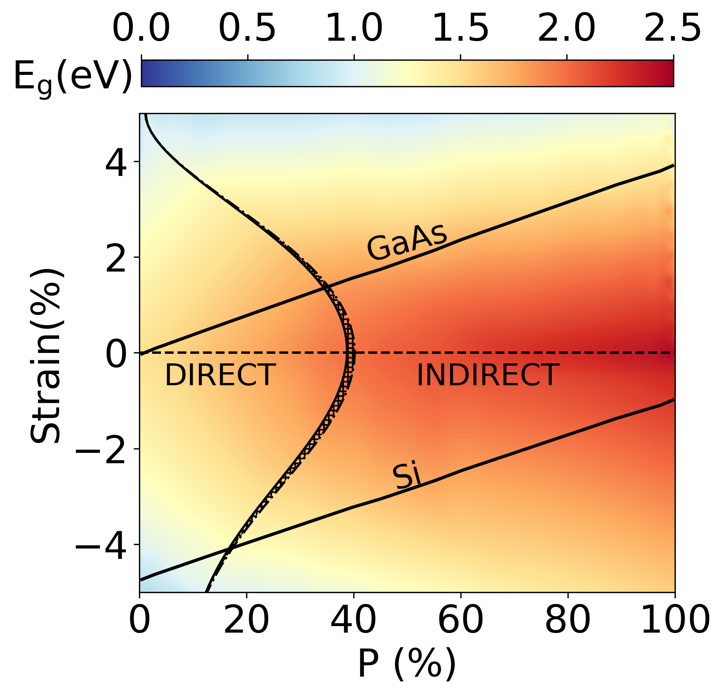
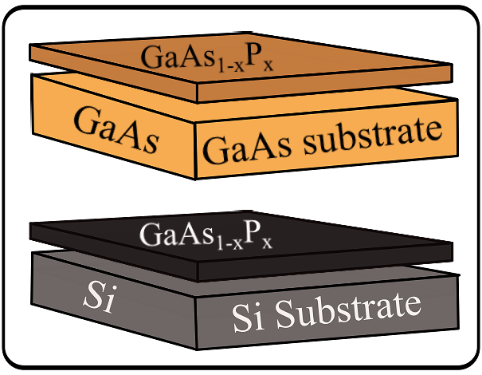
Ternary III-V systems
Bandgap phase diagram: Ga(AsP) biaxial strain
direct bandgap
X
indirect bandgap
X
B. Mondal, M. Kröner, T. Hepp, K. Volz and R. Tonner-Zech, arXiv:2302.14547 (2023)

Slide 26
Bloch spectral weight
$$Ψ_{Km}\left(r\right)=\left|Km\right\rangle =\sum_{G}{C_{Km}\left(G\right)e^{i\left(K+G\right).r}}$$
$$ω_{Km}\left(k_{i}\right)=\sum_{n}{{\left|\left\langle Km | k_{i}n\right\rangle \right|}^{2}}=\sum_{g}{{\left|C_{Km}\left(g+k_{i}−K\right)\right|}^{2}=\sum_{g}{{\left|C_{Km}\left(g+Gj\right)\right|}^{2}}}$$
Probability of finding a set of PC states $\left|k_{i}n\right\rangle$ contributing to SC state $\left|Km\right\rangle$
Or,
The amount of Bloch character $k_{i}$ preserved in $\left|Km\right\rangle$ at the same energy
fold2Bloch: https://github.com/rubel175/fold2Bloch-VASP, last accessed 2022
V. Popescu, A. Zunger, Phys. Rev. b 85, 085201 (2012)

Slide 27
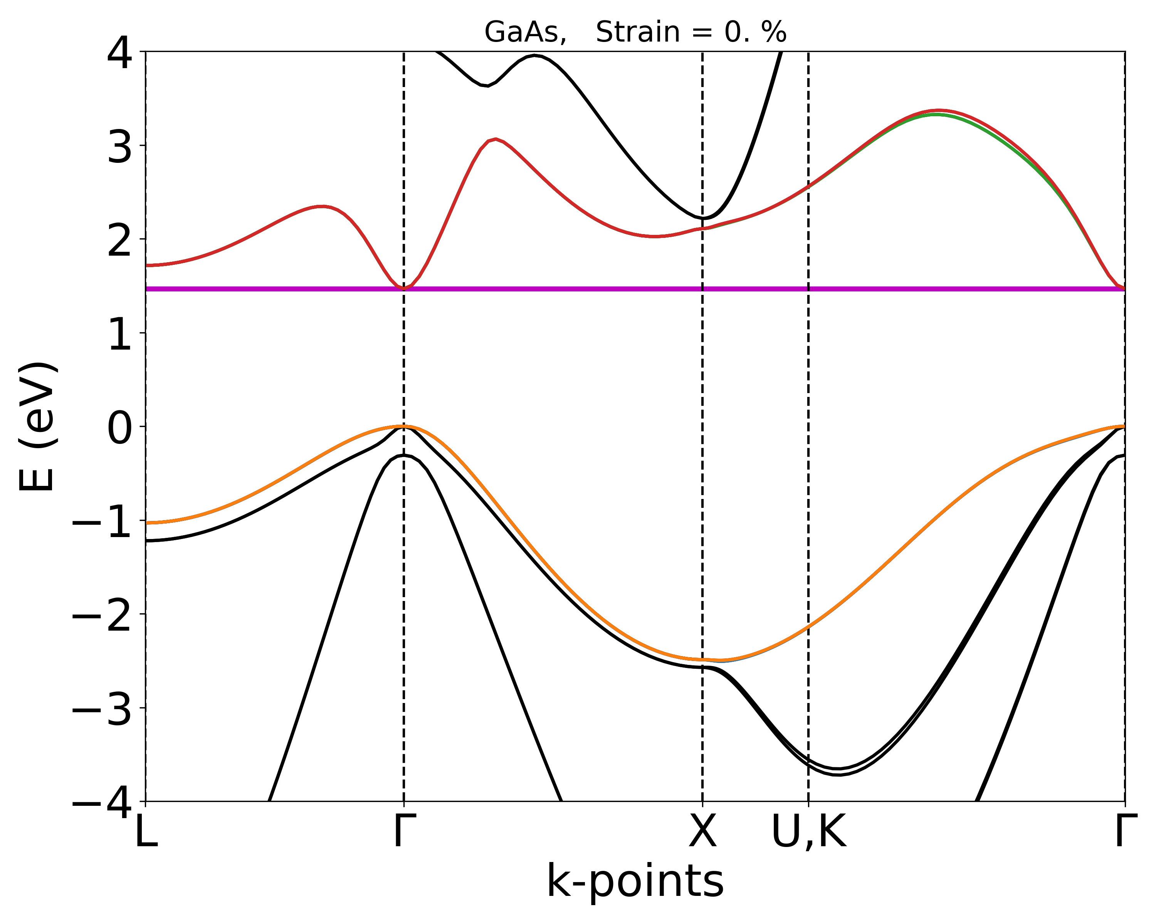
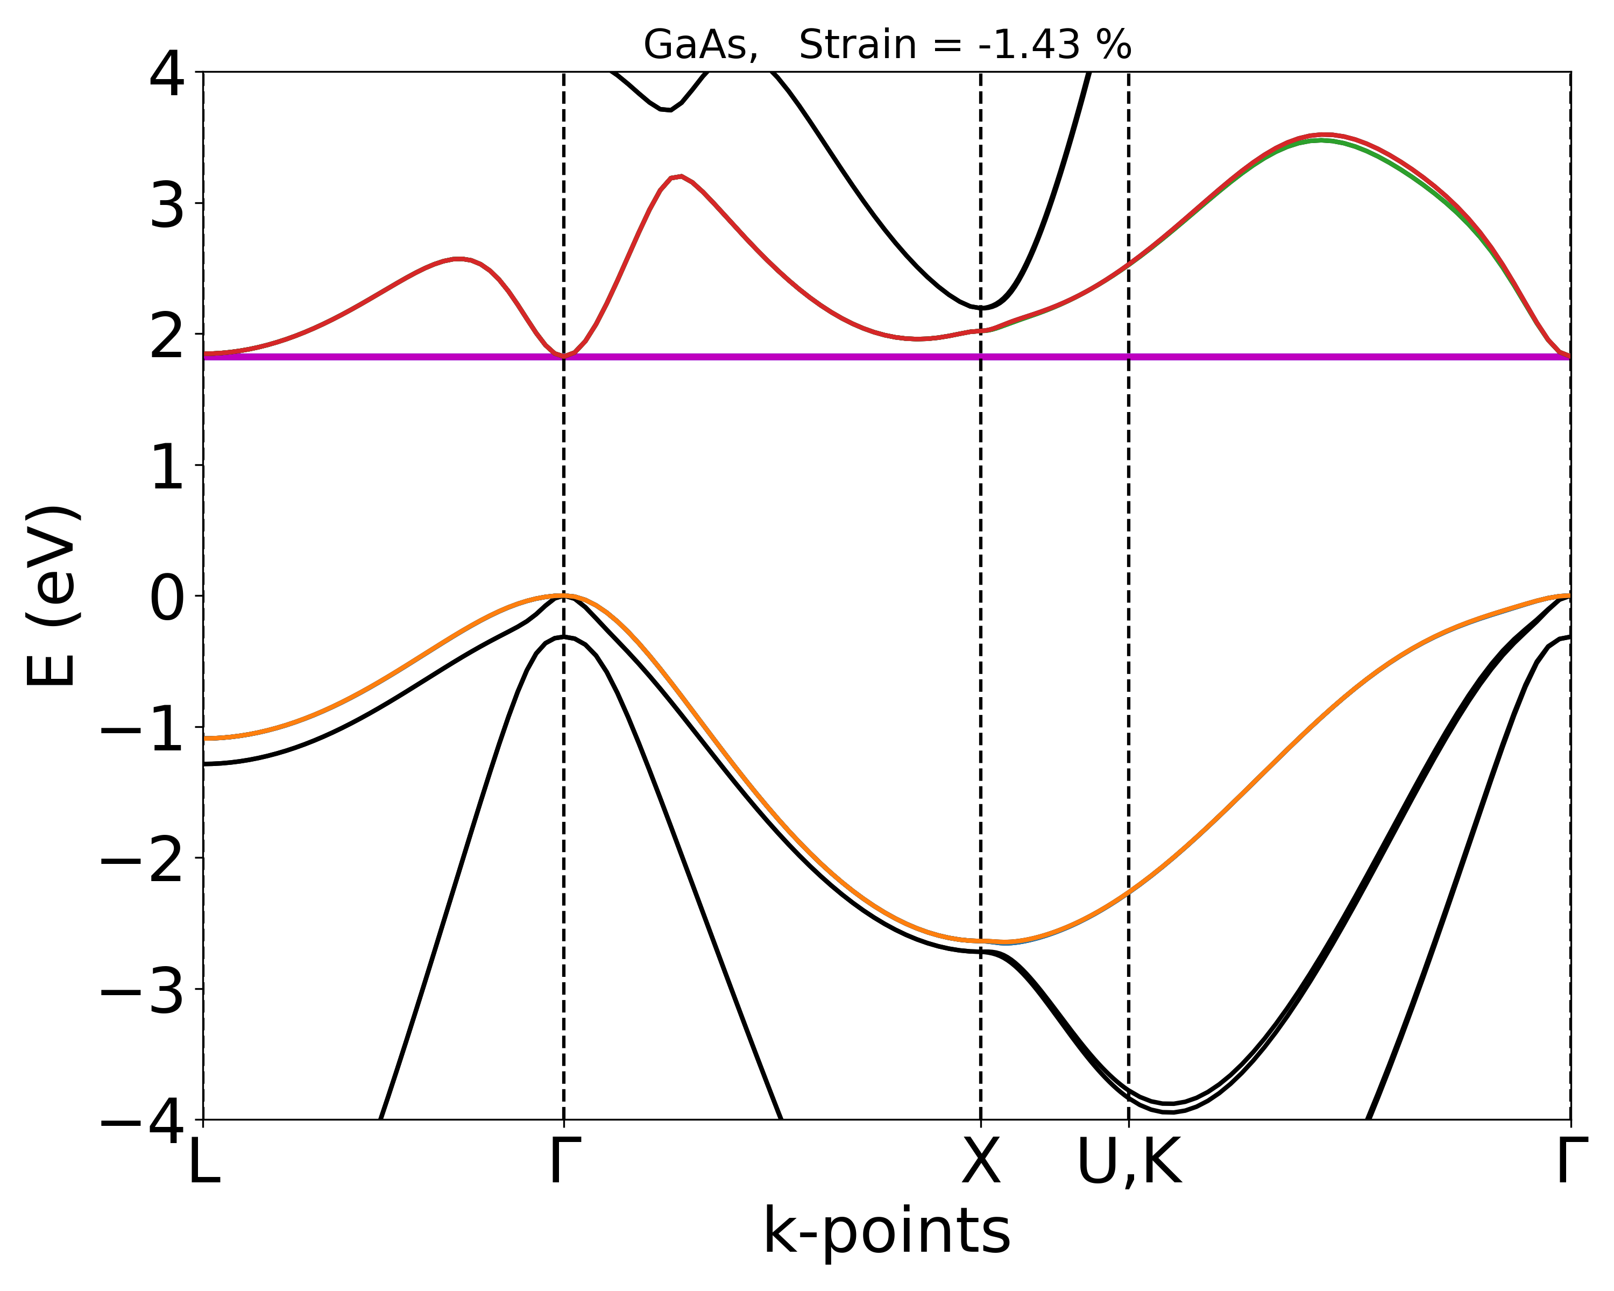
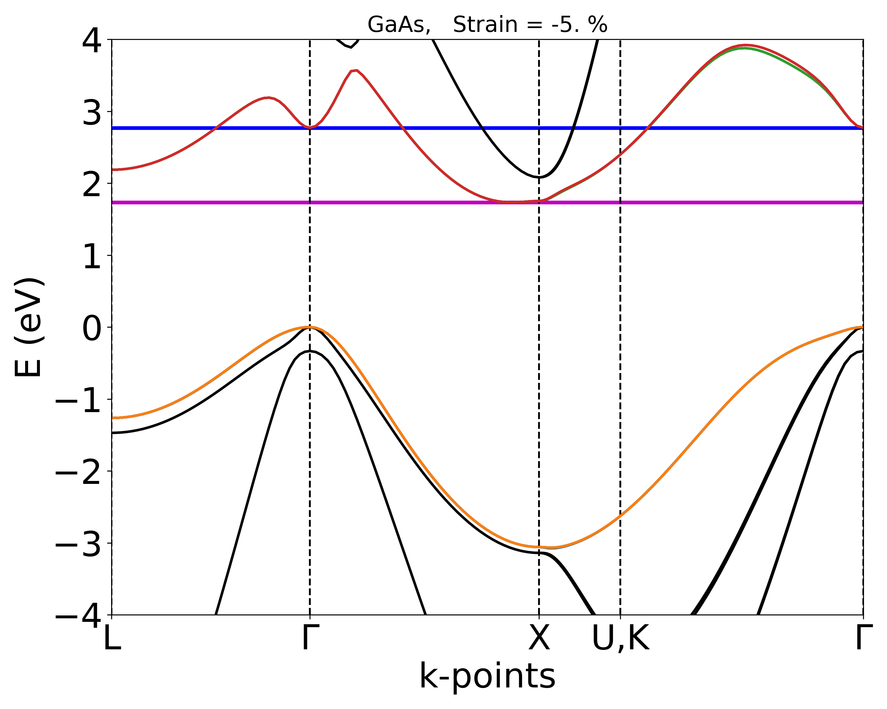
GaAs: isotropic compressive strain
(Γ : L : X) Bloch weights
Γ : L : X = 100:0:0
Γ : L : X = 50:50:0
Γ : L : X = 0:0:100
Direct bandgap
Direct-indirect transition
Indirect bandgap

Slide 28
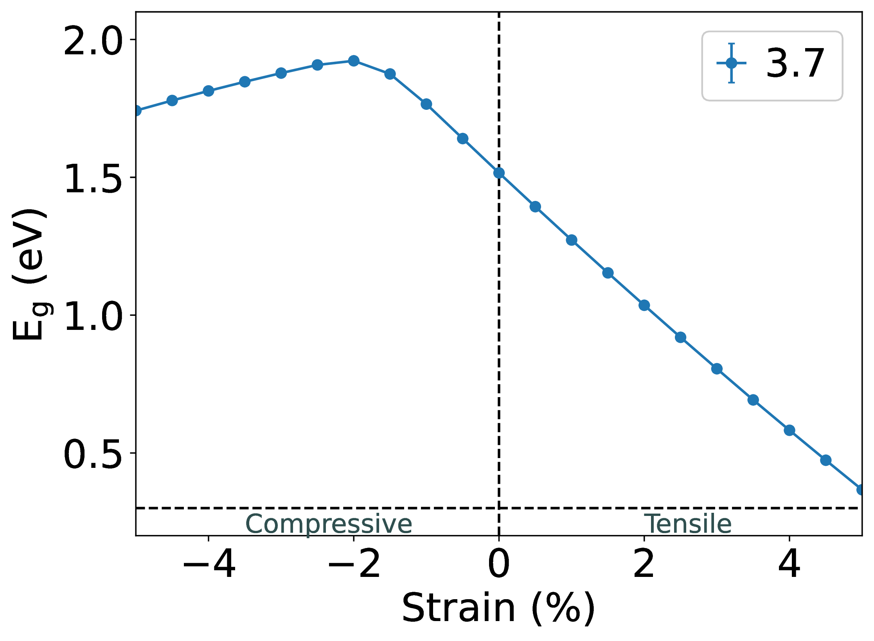
Direct-indirect transition
GaAs isotropic strain
GaAs_{0.963}P_{0.037} isotropic strain

Slide 29
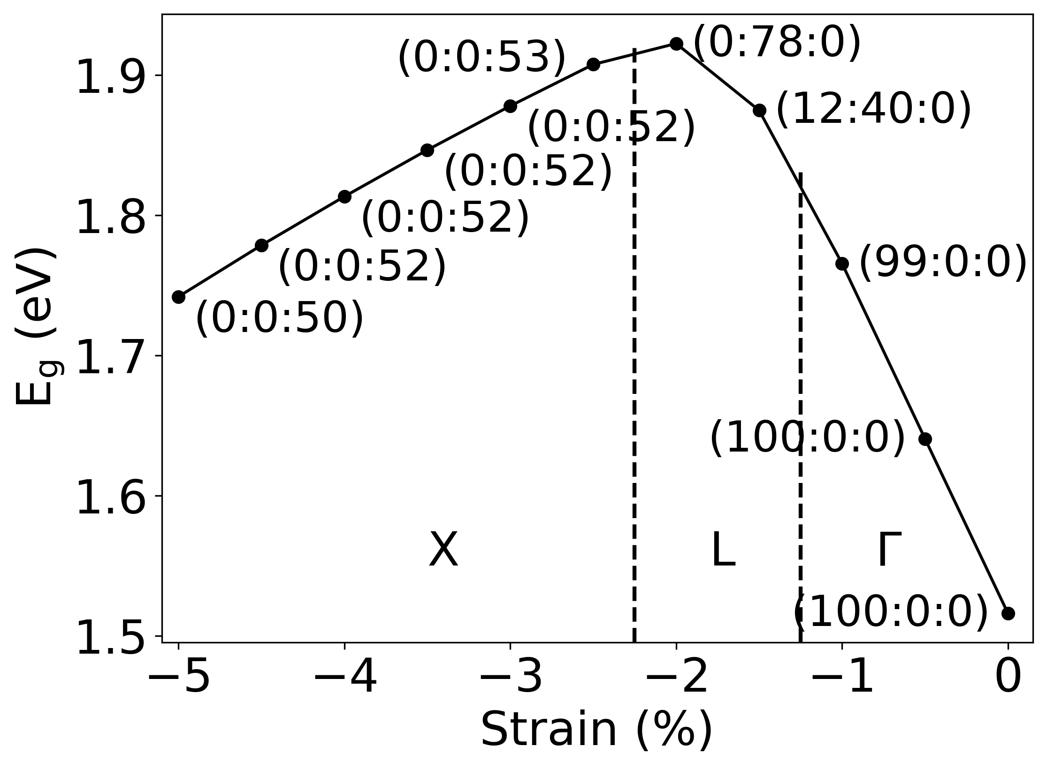
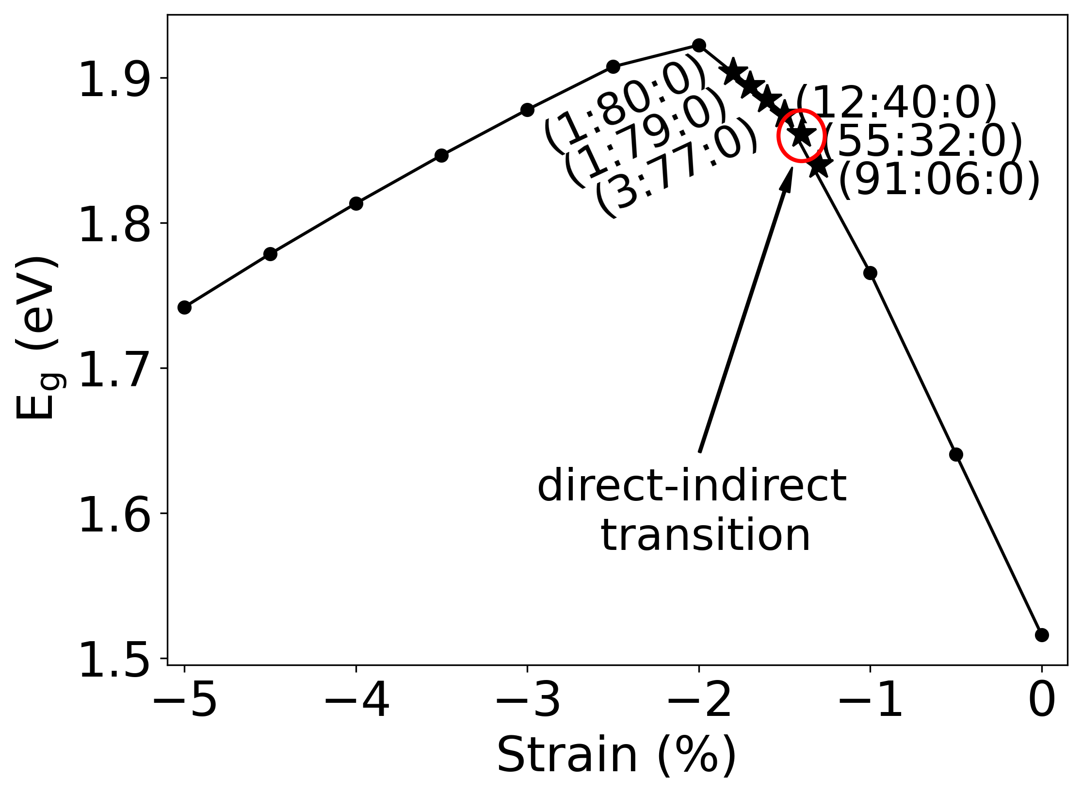
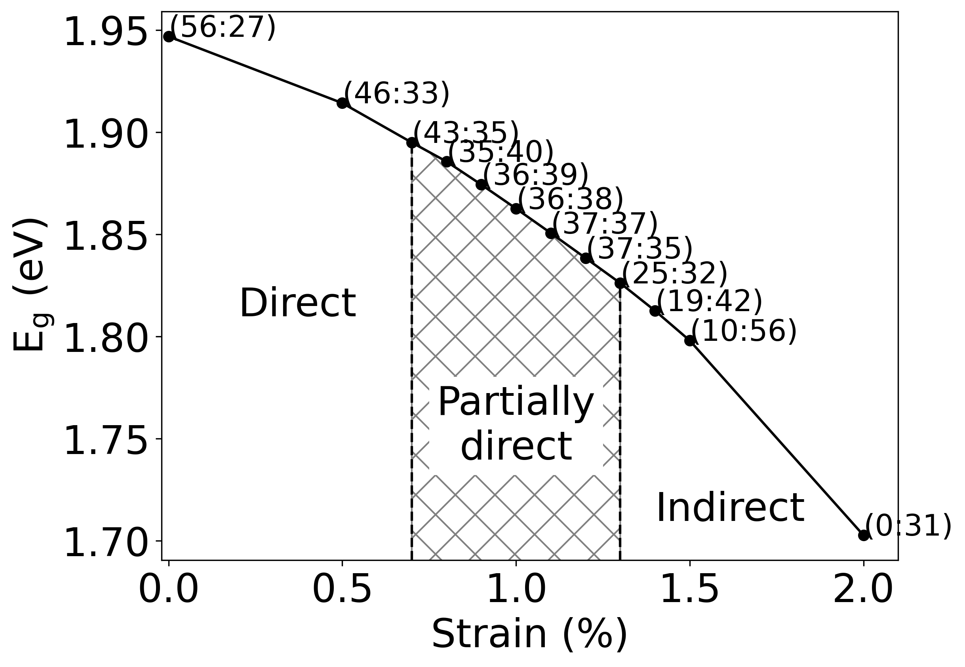
GaAsP: Direct-indirect transition
(Γ : L : X) Bloch weights
(Γ : [L or X]) Bloch weights
GaAs_{0.963}P_{0.037}
isotropic compressive strain
GaAs_{0.63}P_{0.37}
Biaxial tensile strain

Slide 30
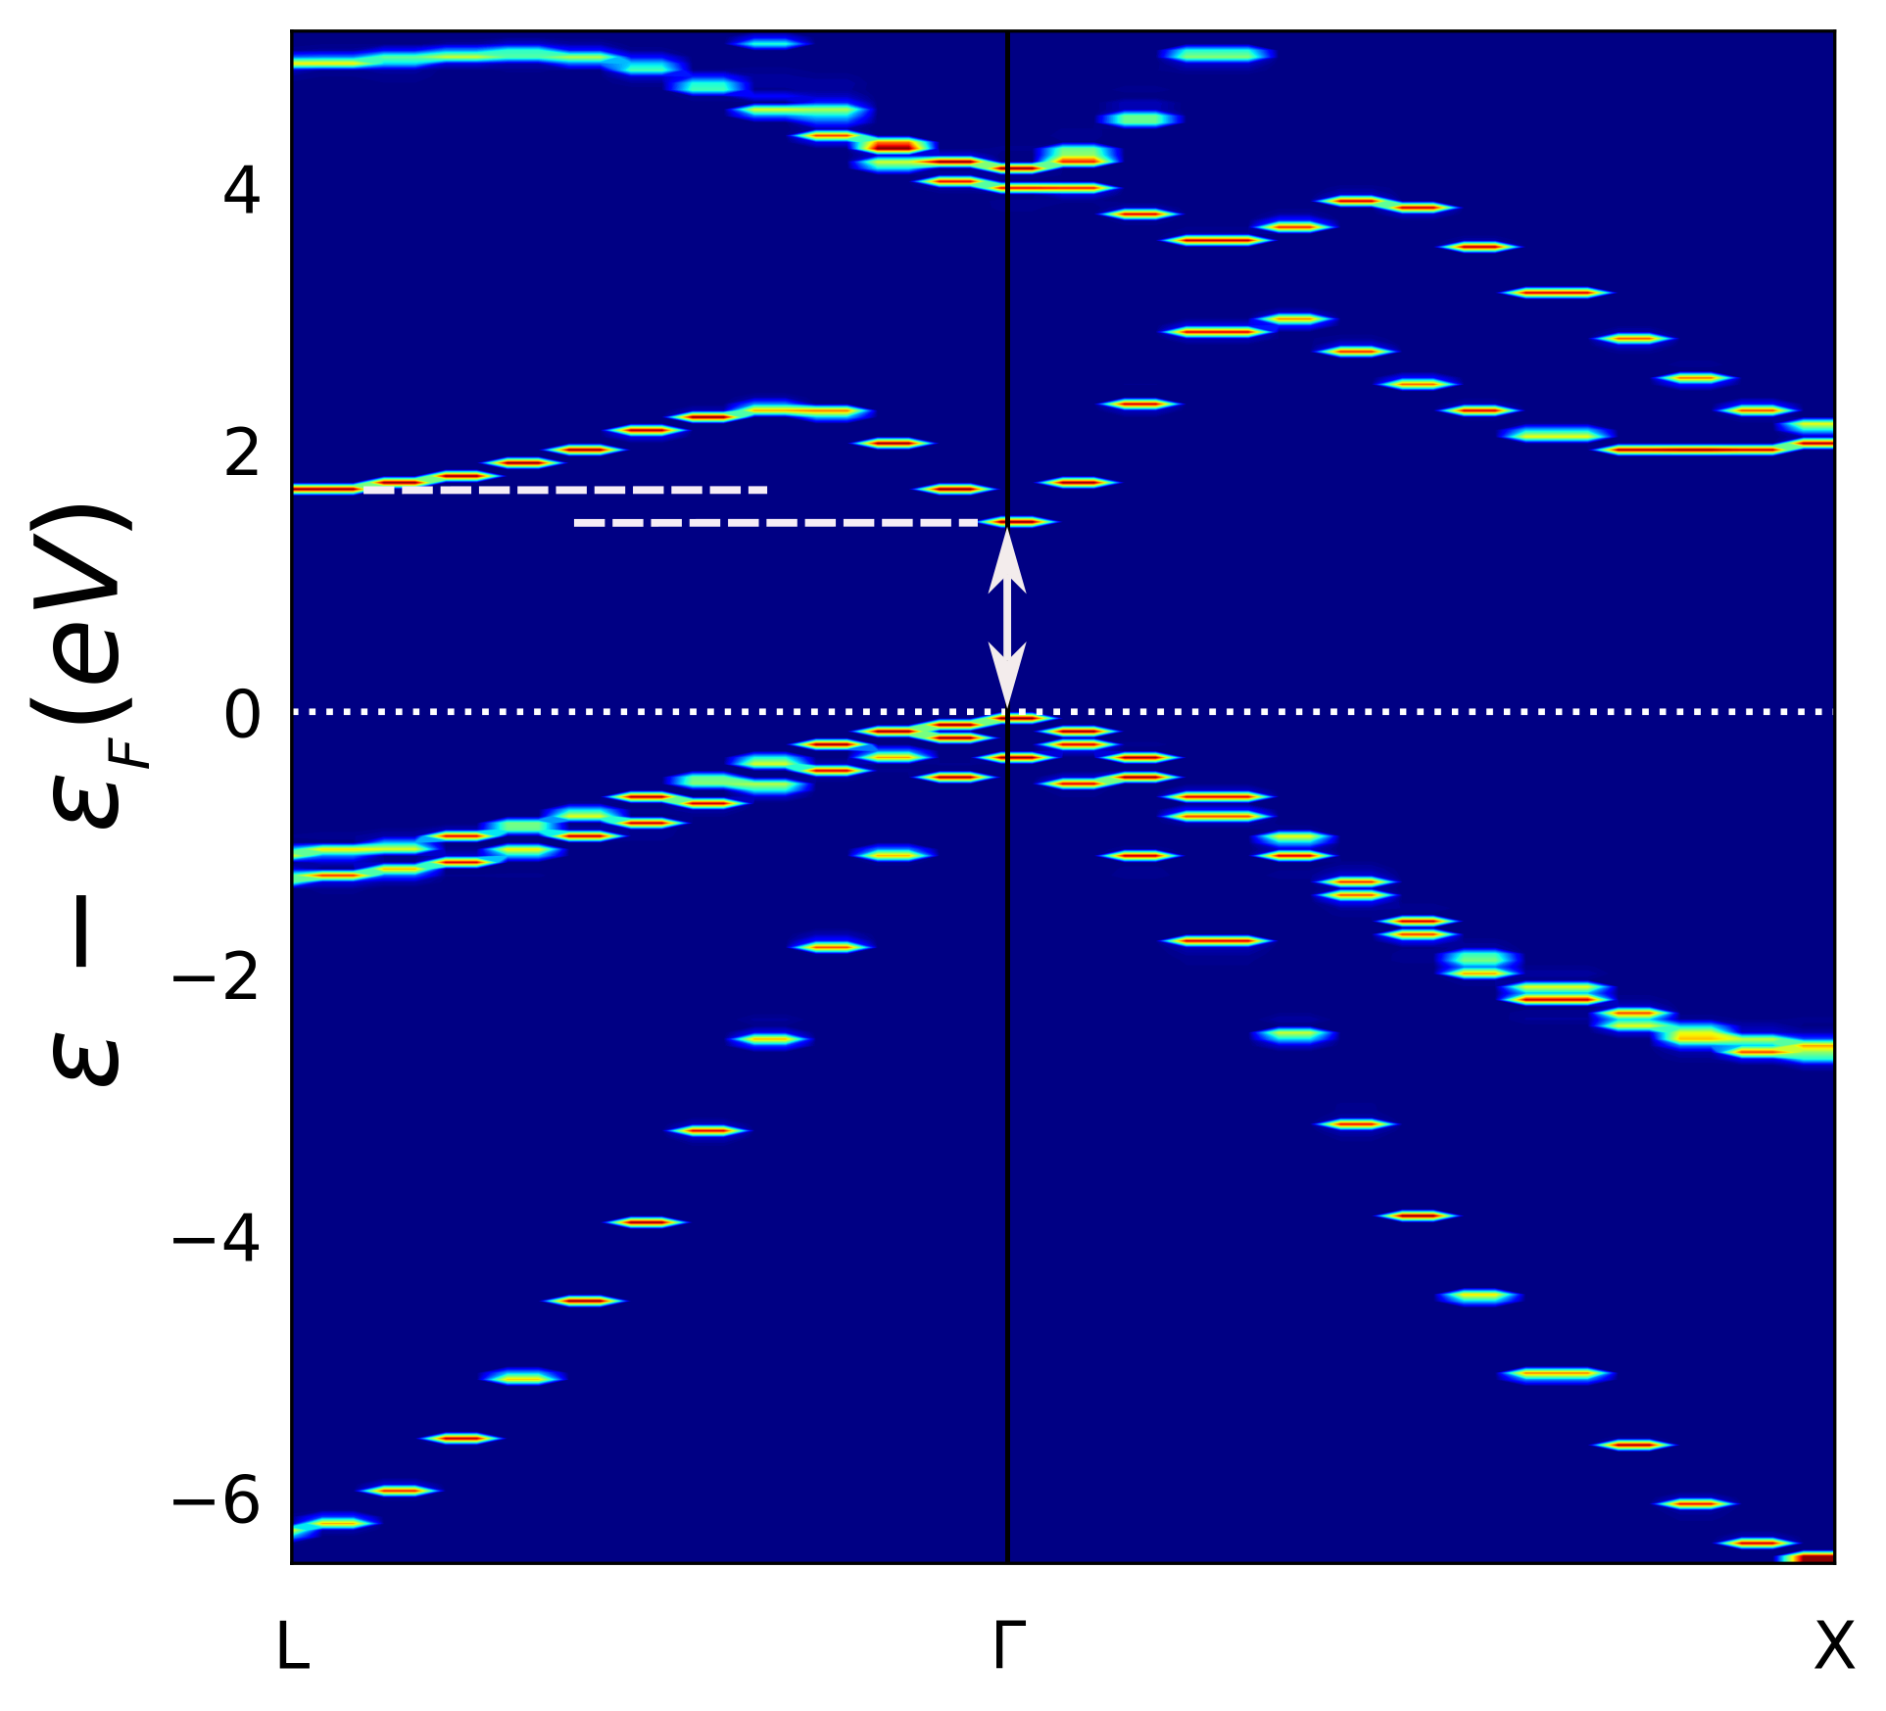
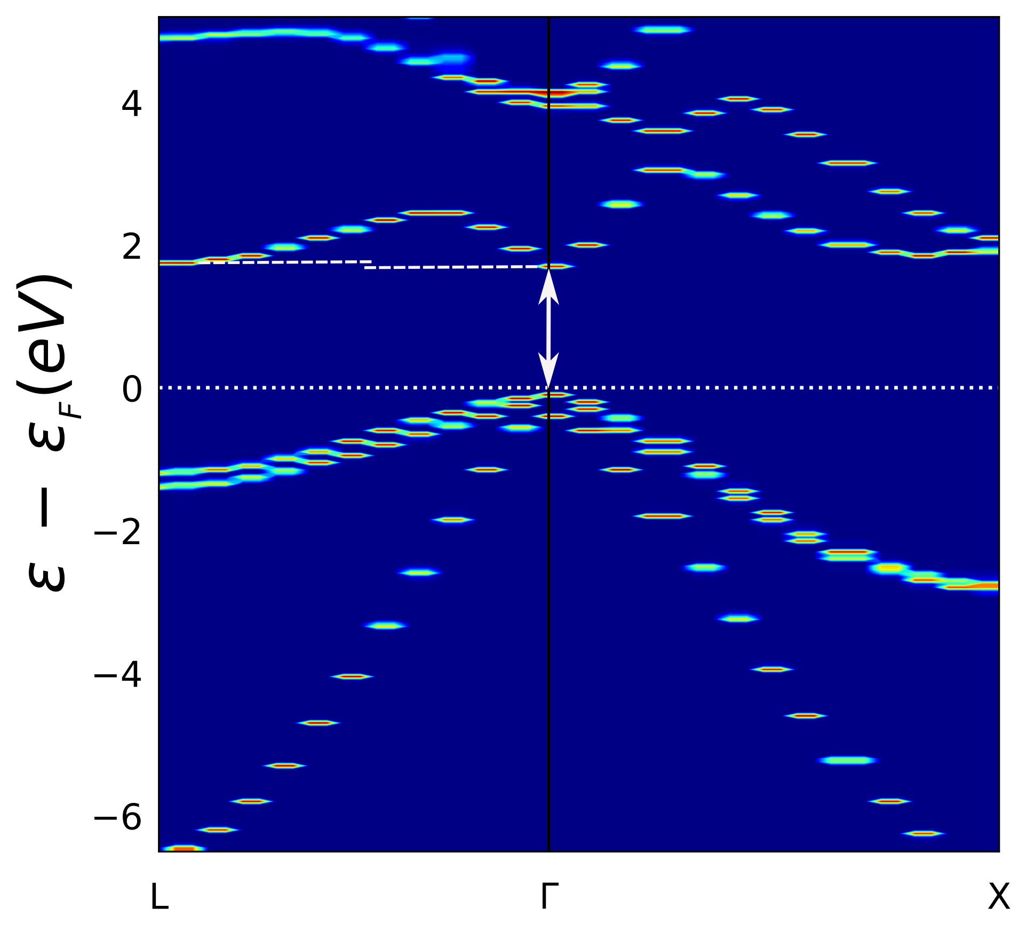
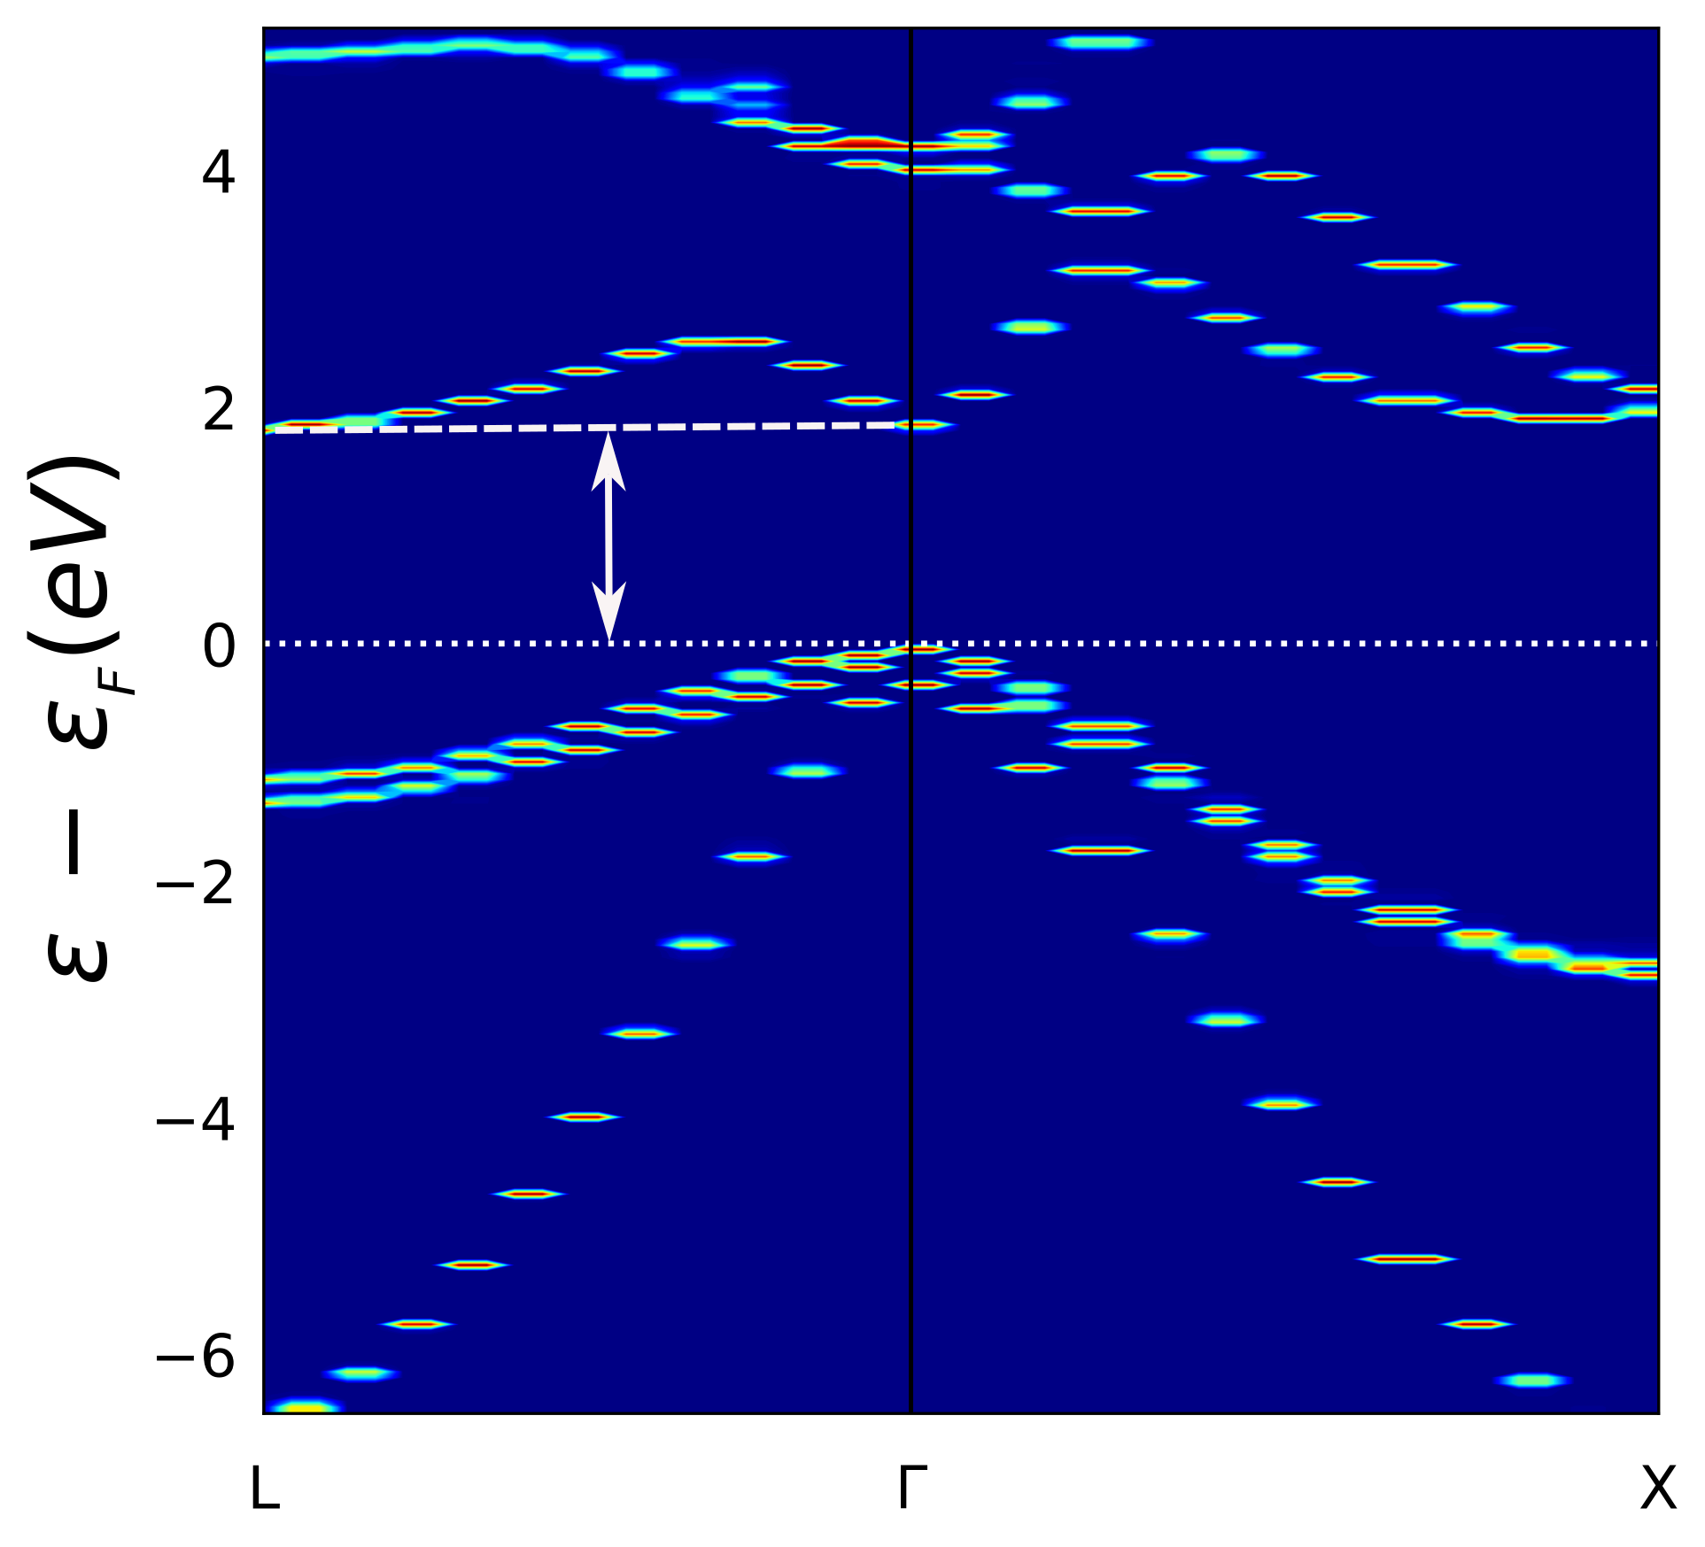
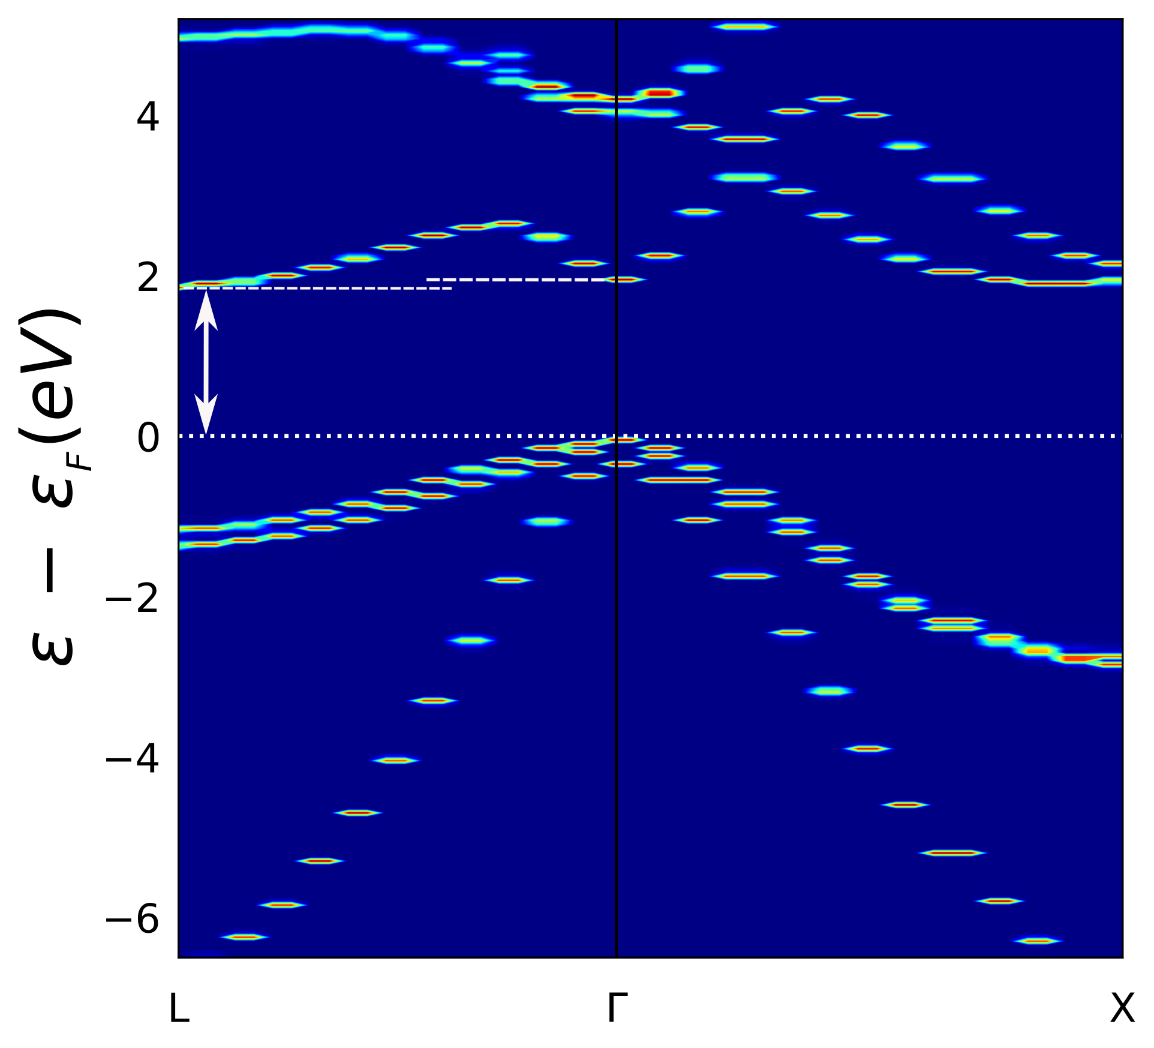
GaAsP bandstructures
GaAs_{0.963}P_{0.037}: Isotropic compressive strain
Strain = 0.0%
Strain = −1.3%
Strain = −1.5%
Strain = −2.0%
Direct bandgap
Direct bandgap
Direct-indirect
transition
Indirect bandgap
B. Mondal, M. Kröner, T. Hepp, K. Volz and R. Tonner-Zech, arXiv:2302.14547 (2023)

Slide 31
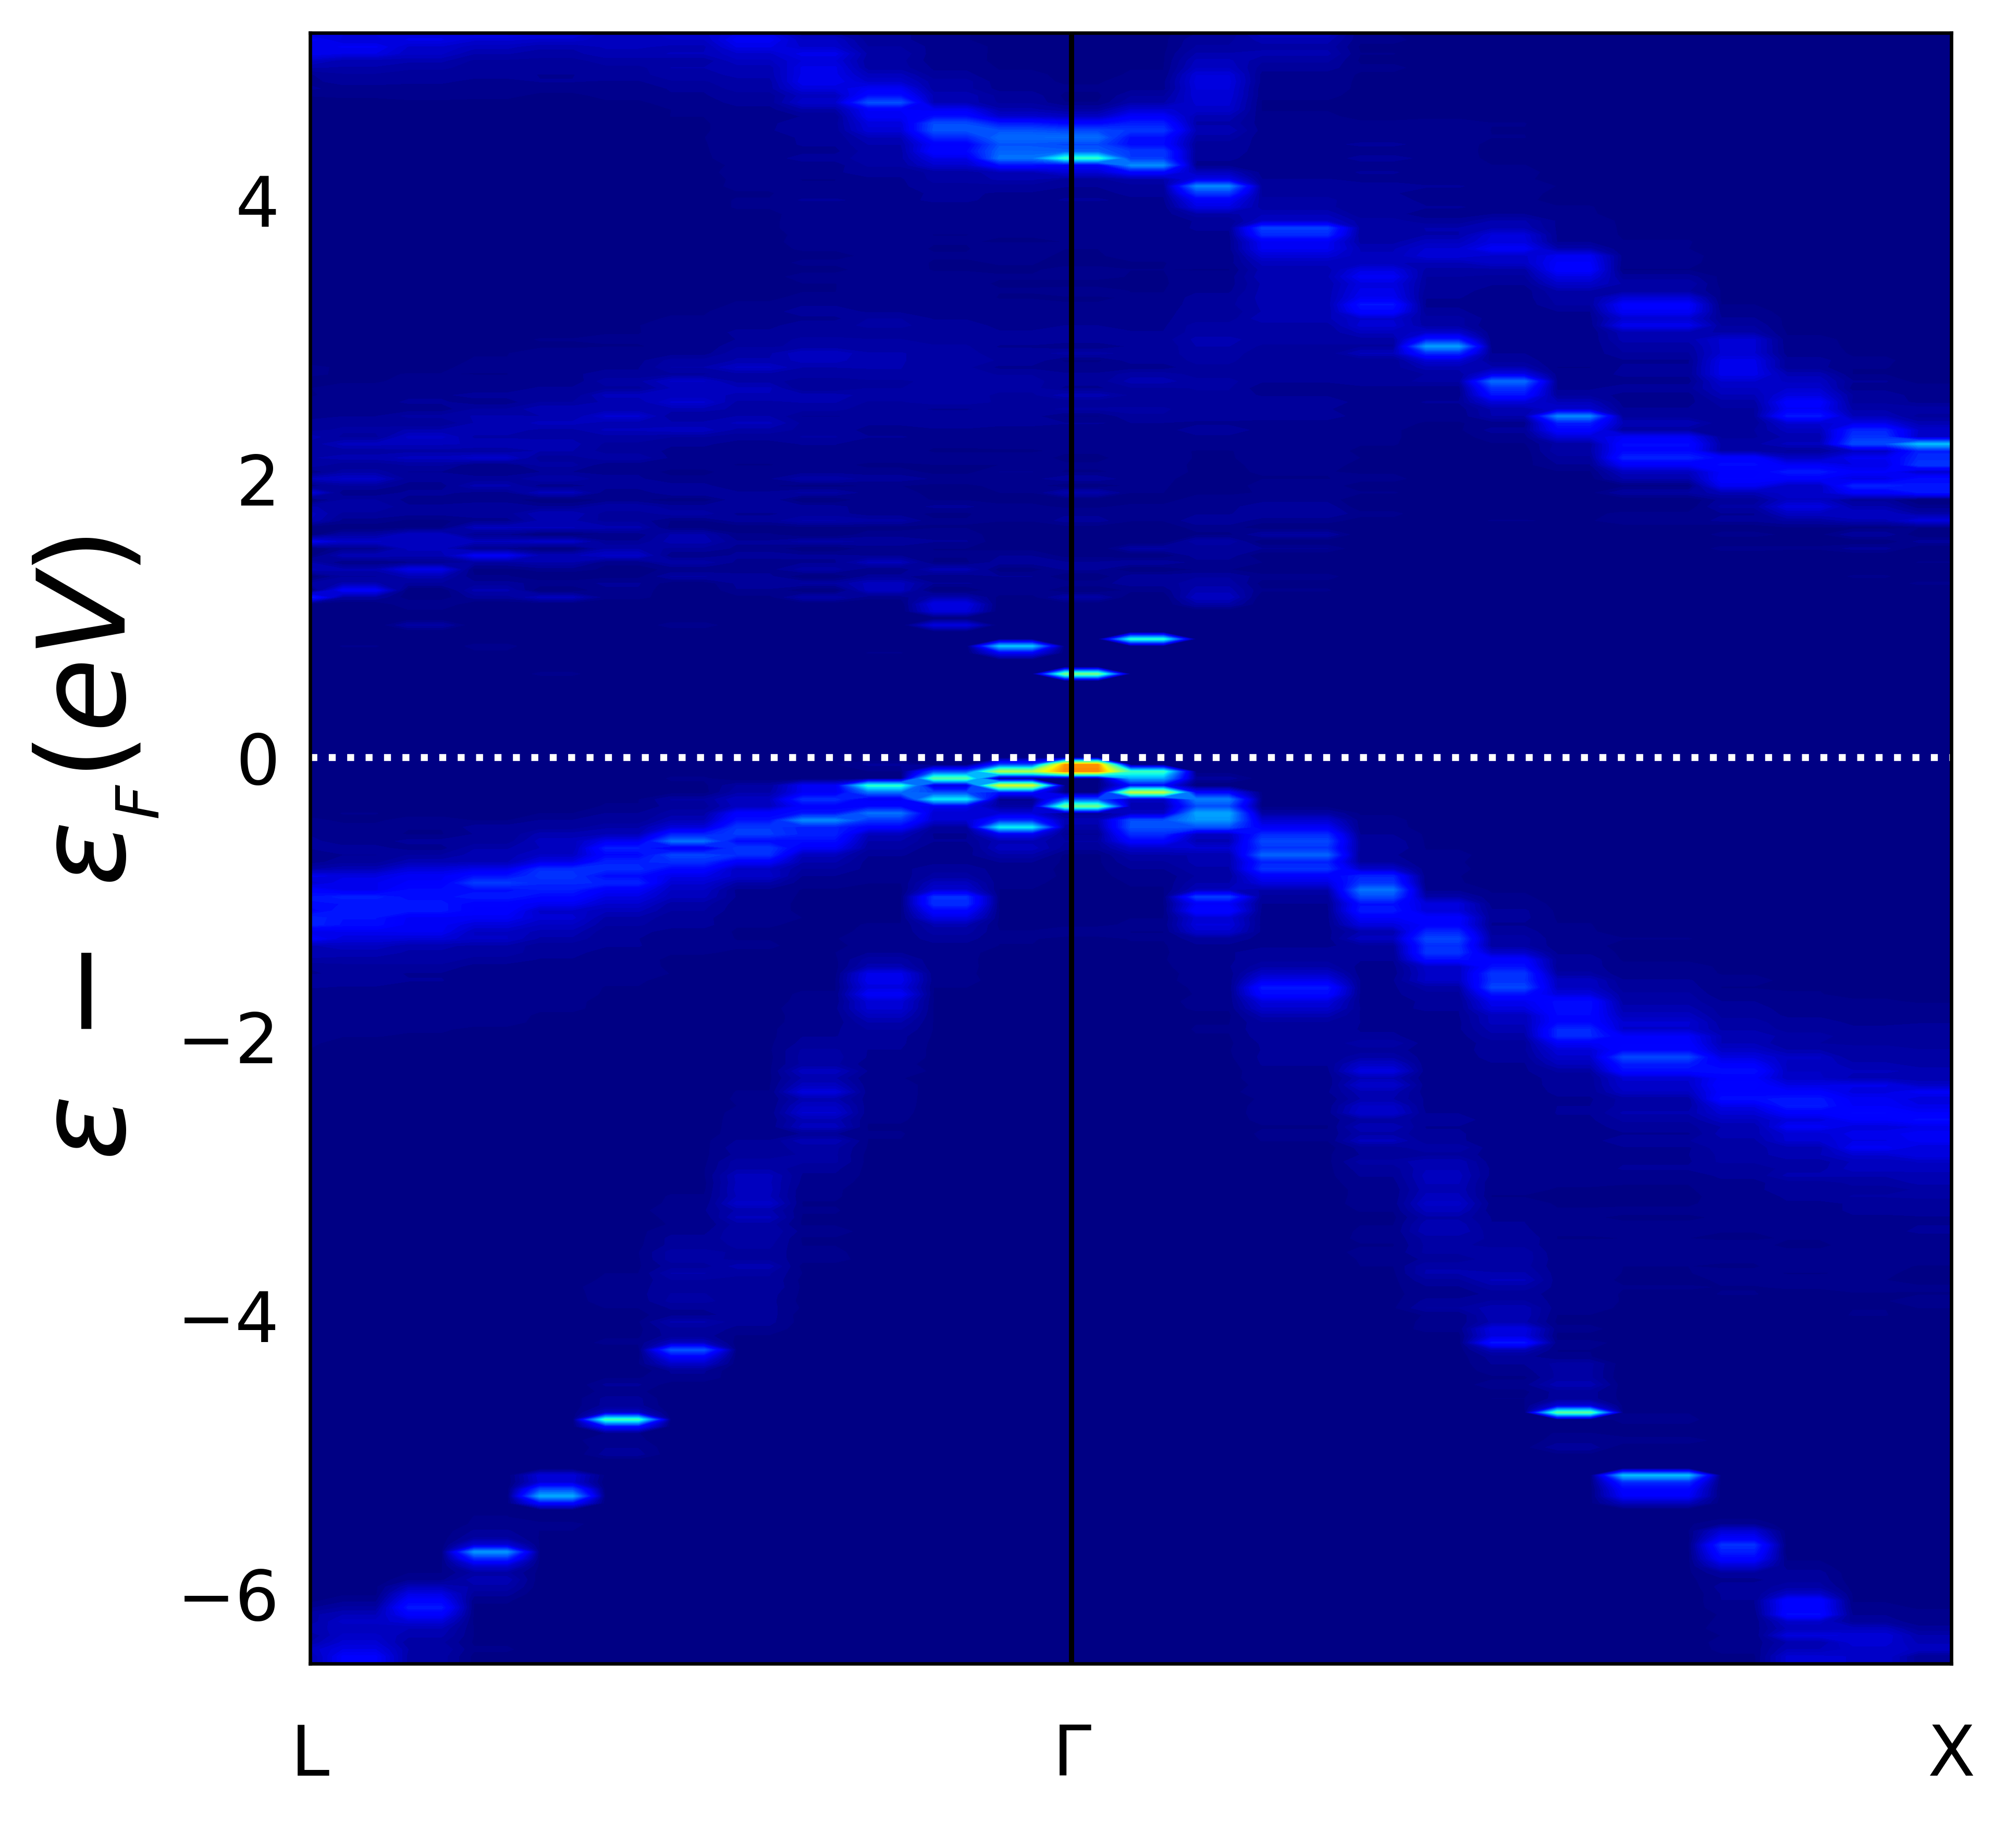
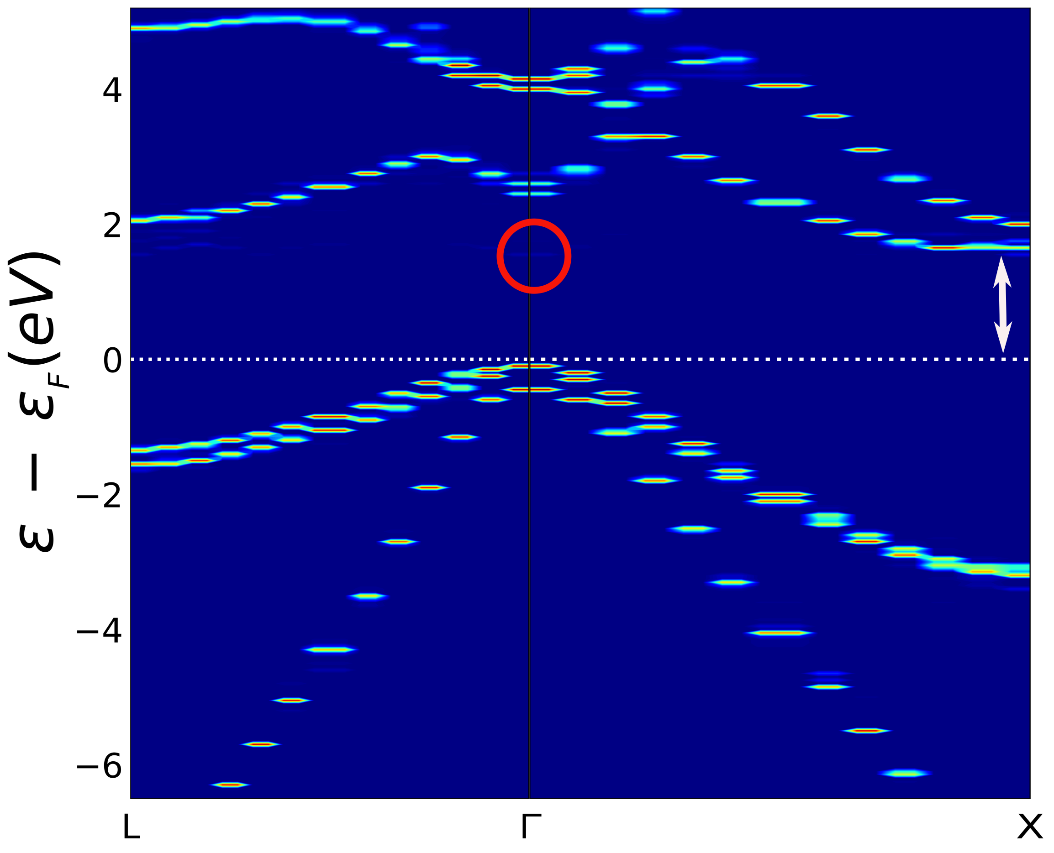
GaAsN bandstructures
GaAs_{0.995}N_{0.005}: Isotropic strain
Strain = 0.0%
Strain = −4.5%
Strain = 0.0%
Strain = +4.5%
Indirect bandgap
Direct bandgap
Direct bandgap
Strain = −5.0%
GaAs_{0..889}N_{0.111}
B. Mondal, M. Kröner, T. Hepp, K. Volz and R. Tonner-Zech, arXiv:2302.14547 (2023)

Slide 32
GaAsN bandstructures
GaAs_{0.995}N_{0.005}: Isotropic compressive strain band redefinition
Strain = −4.5%
Indirect bandgap
Γ : L : X Bloch weights
B. Mondal, M. Kröner, T. Hepp, K. Volz and R. Tonner-Zech, arXiv:2302.14547 (2023)

Slide 33
Experimental comparison III-V binary systems
System | Unstrained bandgap (eV) |  | Isotropic strain DIT(%) |  | Transitions
 | Calculated | Experiment | Calculated | Experiment | Calculated | Experiment
Si | 1.19 | 1.17 | − | − | − | −
GaP | 2.36 | 2.34 | − | − | − | −
GaAs | 1.47 | 1.52 | −1.56 | −2.75 | Γ→L | Γ→X
GaSb | 0.64 | 0.81 | −1.00 | −1.54 | Γ→L | Γ→L
InP | 1.43 | 1.42 | −4.40 | −5.16 | Γ→X | Γ→X
InAs | 0.36 | 0.39 | −7.41 | −8.25 | Γ→X | Γ→X
InSb | 0.03 | 0.24 | −5.18 | −4.23 | Γ→L | Γ→X
*RMSE = 0.11 eV
*RMSE = 0.03 eV
*RMSE = 0.88%
B. Mondal and R. Tonner-Zech, arXiv:2208.10596 (2022)

Slide 34
Experimental comparison III-V ternary systems
QW heterostructures
RT-PL
XRD
System | Substrate | Layer thickness (nm) | Bandgap RMSE (eV)
GaAsP | GaAs | ~10000 | 0.01
GaPSb | GaAs, GaP, GaSb | − | 0.10
GaAsSb | GaAs | ~50 | 0.13
GaAsBi | GaAs | ~50 | 0.10
GaAsN | GaAs | ~10 | 0.12
GaPSb | Si | ~8 | Indirect bandgap
GaPBi | GaP | ~50 | Indirect bandgap
GaAsSb | GaAs | ~4 | 0.42
GaAsN | GaAs, Si | ~6 | 0.66
B. Mondal, M. Kröner, T. Hepp, K. Volz and R. Tonner-Zech, arXiv:2302.14547 (2023)

Slide 35
ML predictions analysis: Ga(AsPSb) biaxial strain
Test set
All input data
Test set
All input data
B. Mondal, J. Westermayr and R. Tonner-Zech, in preparation

